Slide 1




Chlorella vulgaris
Microalgae Photobioreactor
“Turning the world from gray to green”

Slide 2

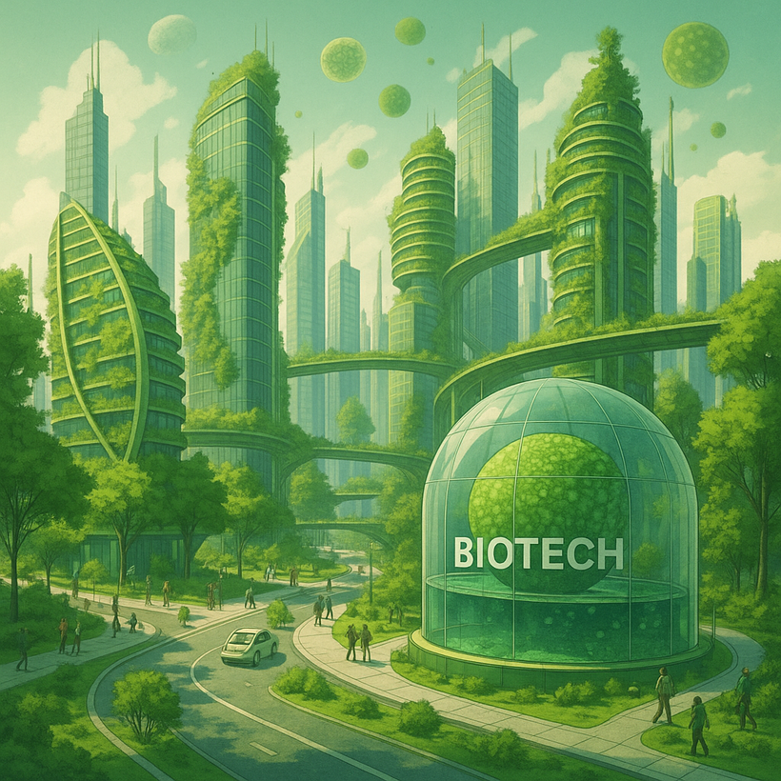
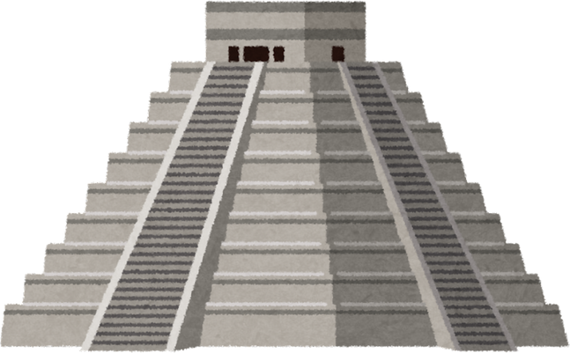


Ziutik
Ziutik in Nahuatl means the color green
Our objective is to develop new biotechnologies inspired by the microalgae Chlorella Vulgaris

Slide 3
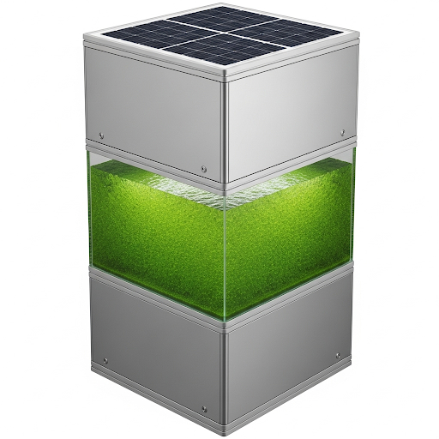
Photobioreactor
A photobioreactor is a device designed for cultivating photoautotrophic organisms using artificial light sources or sunlight to facilitate photosynthesis. Its objective is to reduce environmental CO₂ emissions generation (5 liter container).

Slide 4
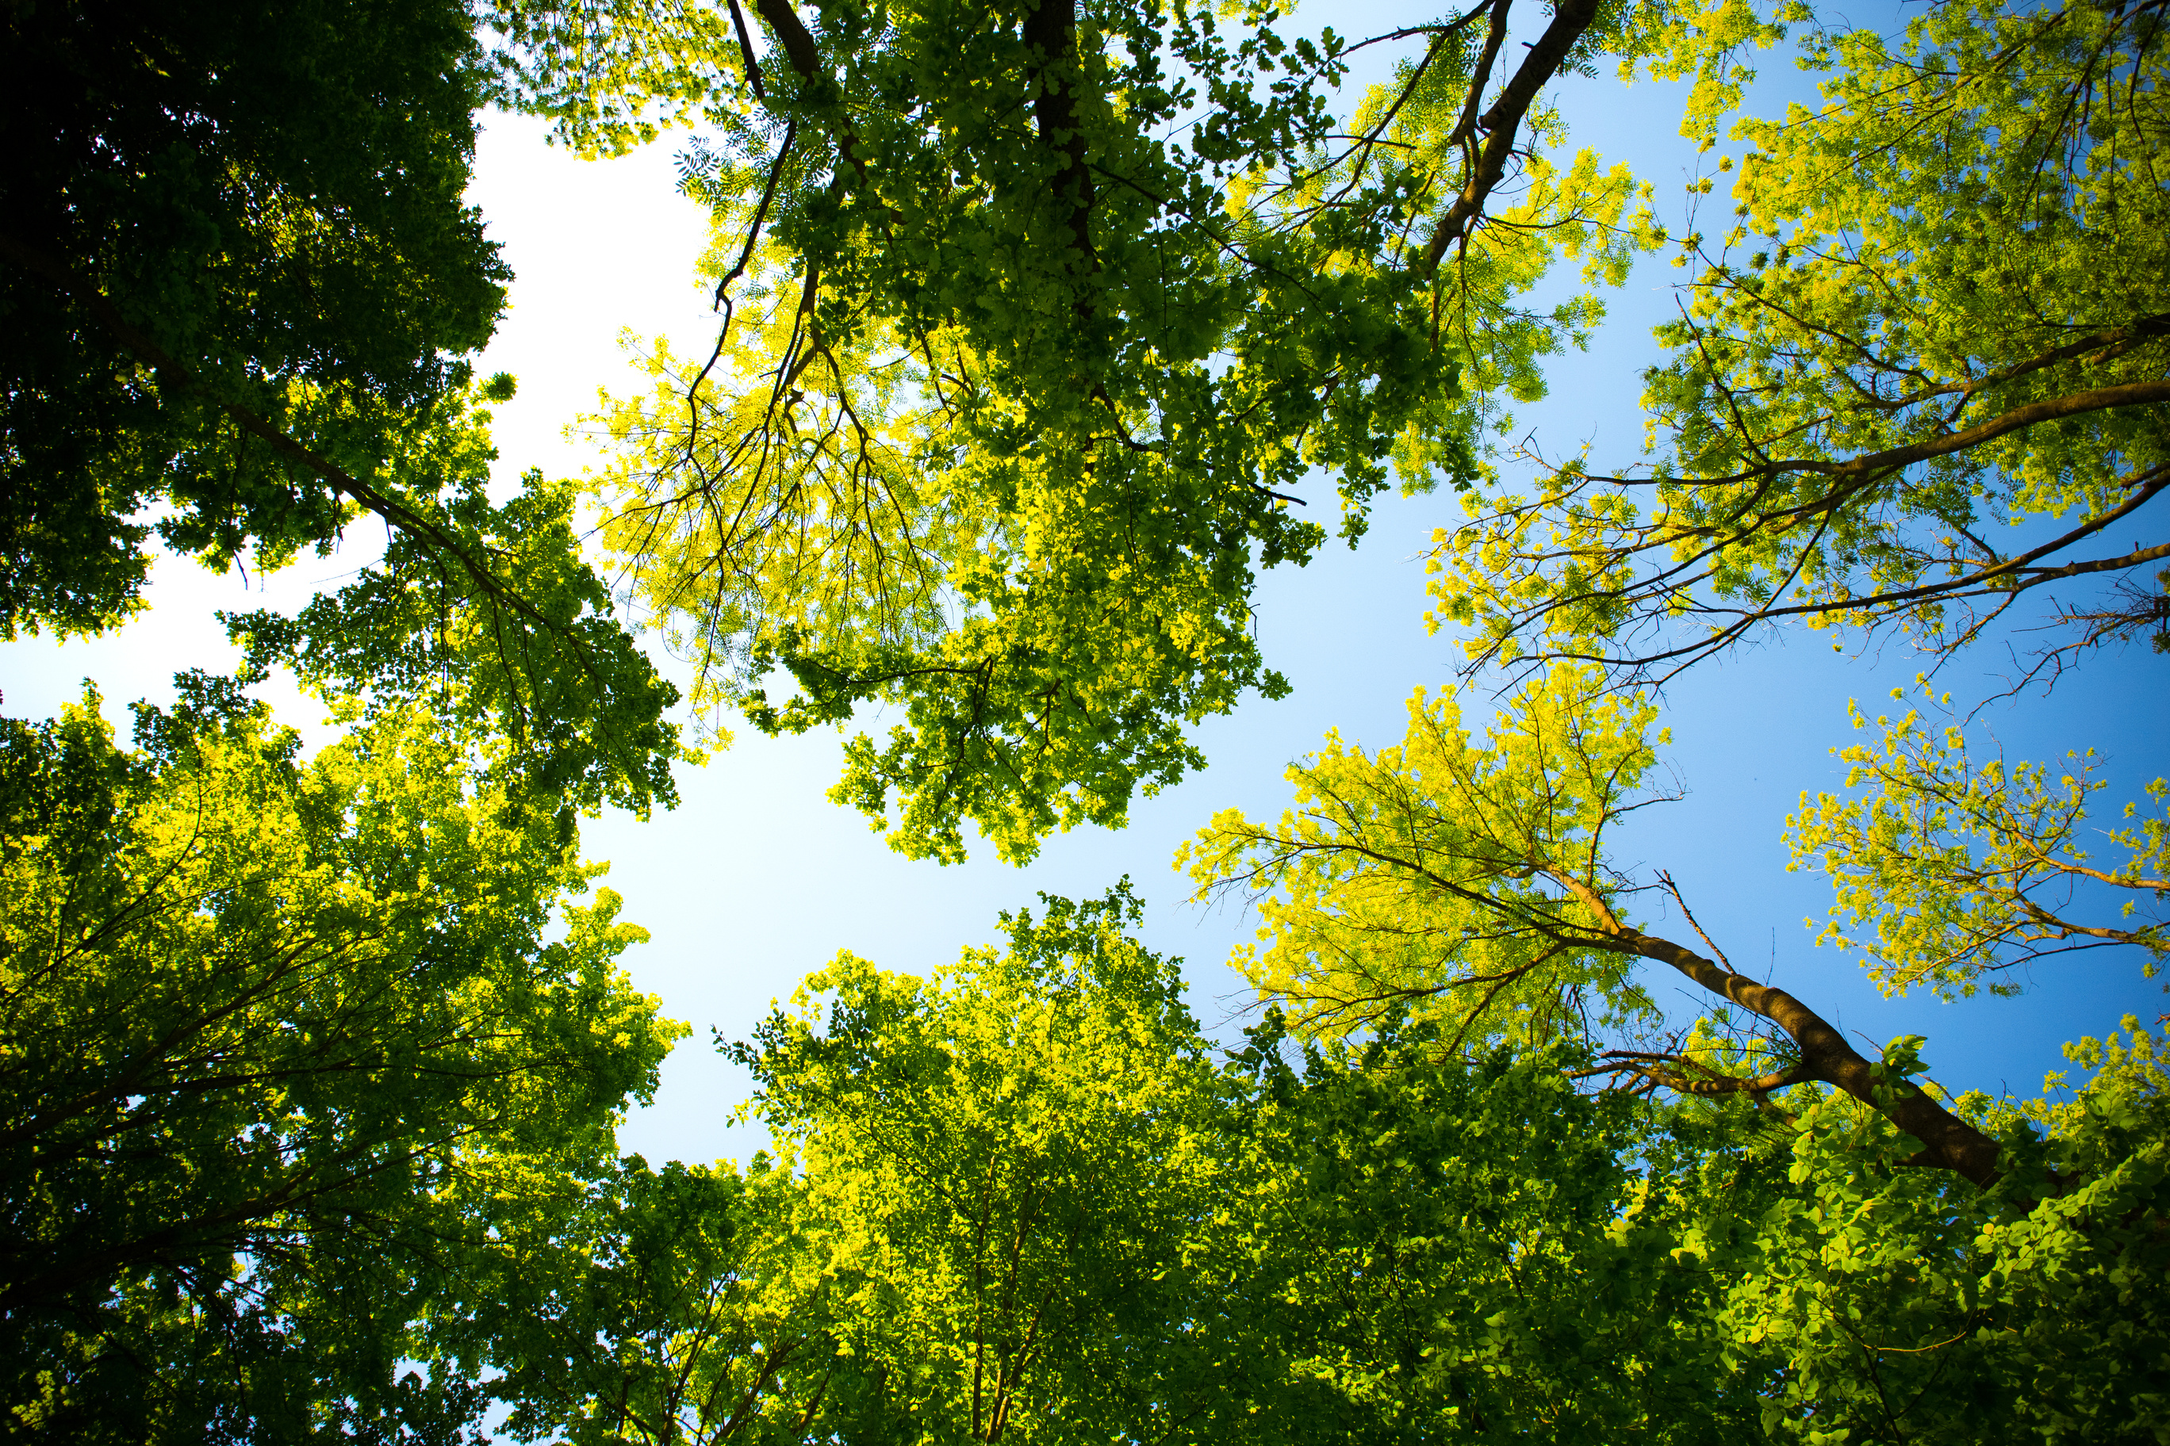



Carbon reduction potential per container
Microalgae Chlorella Vulgaris
1-liter absorbs 1.2 grams of carbon dioxide per day
5-liter units absorbs 6 grams of carbon dioxide per day

Slide 5


Global impact of CO2 absorb per unit
1 YEAR
6 grams of carbon dioxide daily
180 grams of carbon dioxide (30 days)
1MONTH
2,190 grams of carbon dioxide per year (2.19 kg)
1 DAY

Slide 6
Global impact of CO2 absorb per 100,000 unit
1 YEAR
600 kg of carbon dioxide daily
1 MONTH
18 tons of carbon dioxide (30 days)
1 DAY
219 tons of carbon dioxide per year

Slide 7


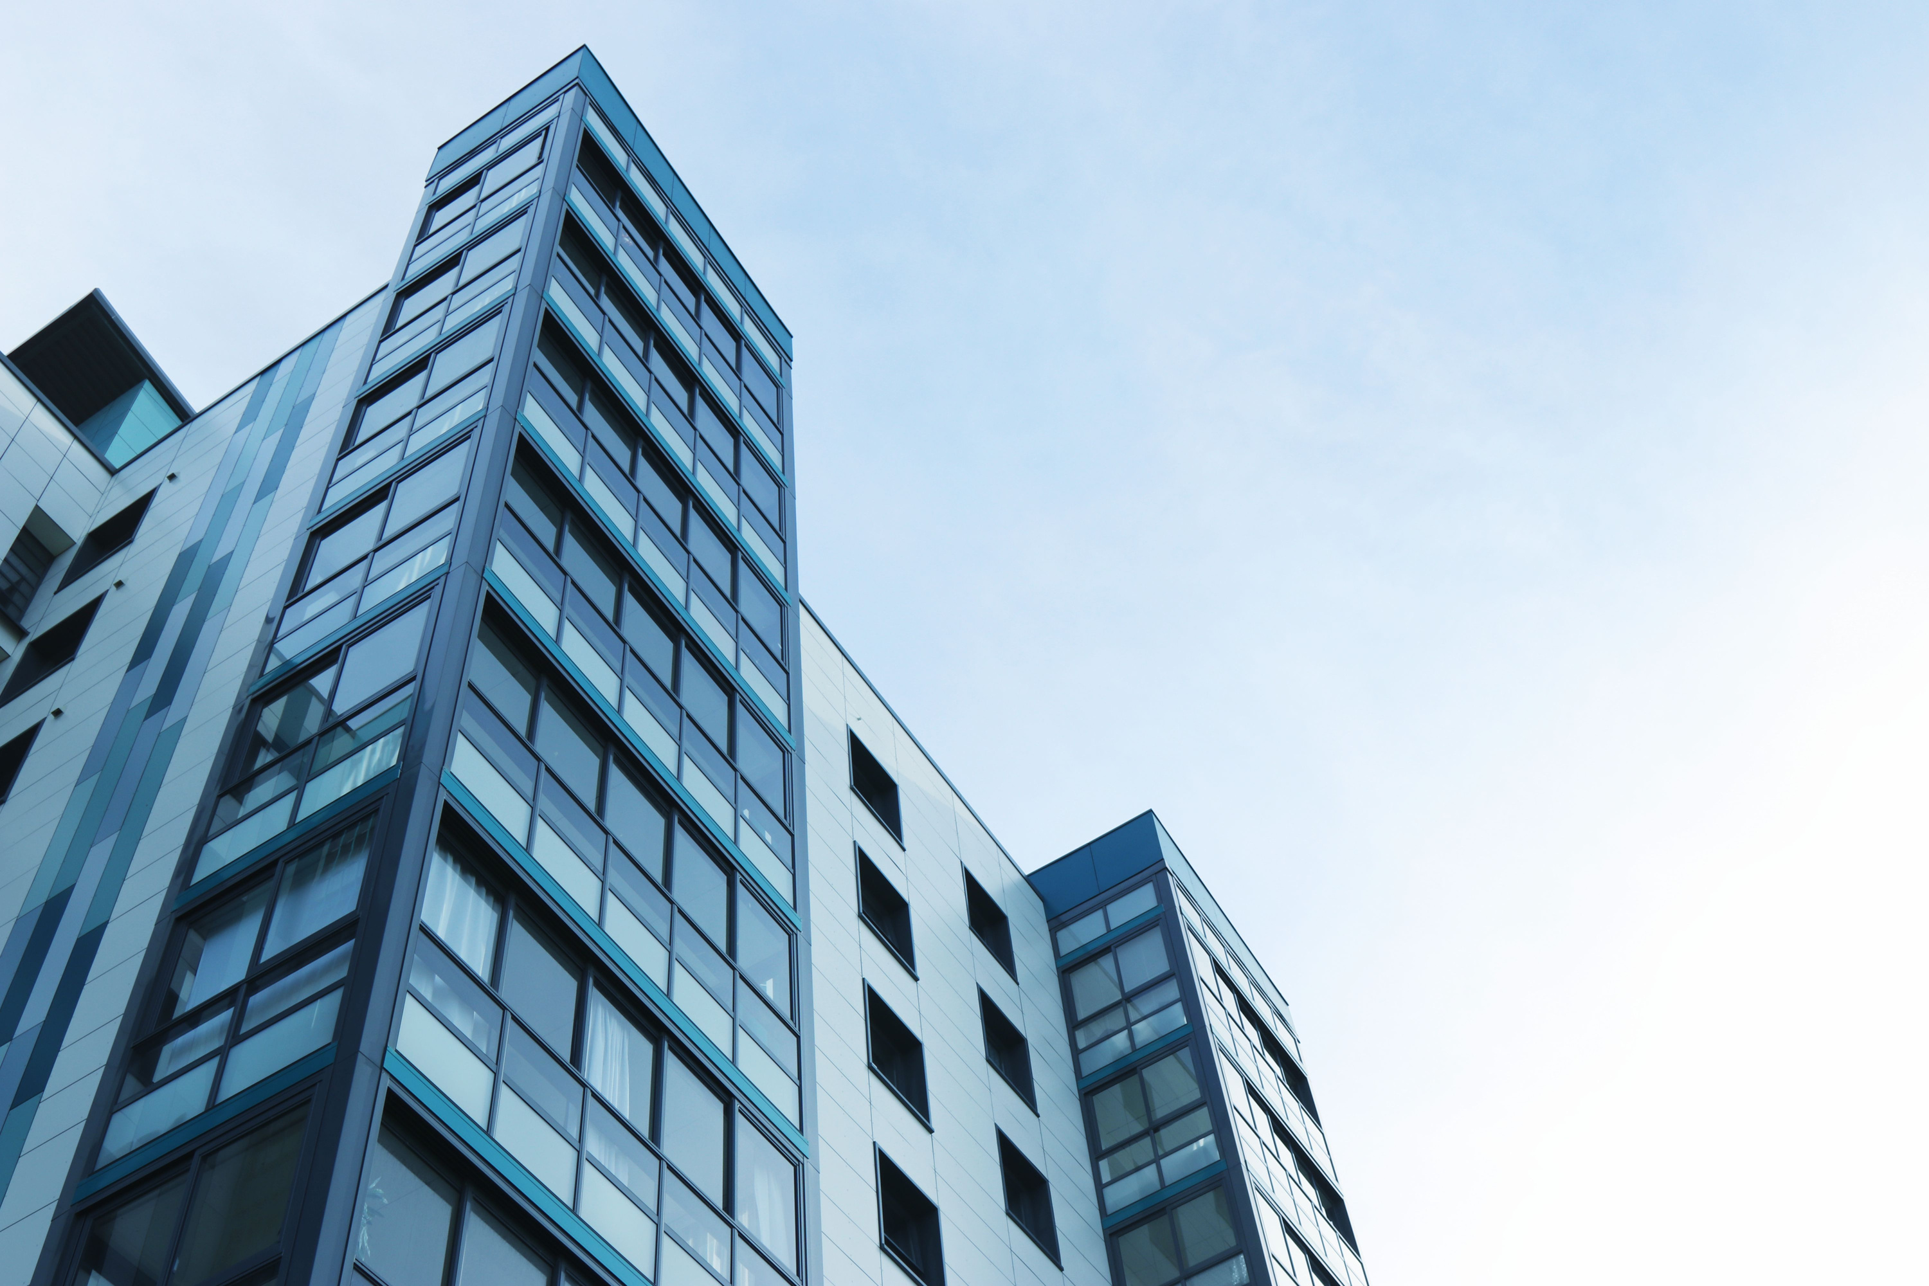




Potential business partners
Real estate agency
Goberment
Large companies
Schools

Slide 8






Cost savings
Initial investment USD 10,665,245
Payback: period: 8 years
Savings of USD 1,438,872 per year
IRR
9.62%
NPV
USD 1,938,992

Slide 9

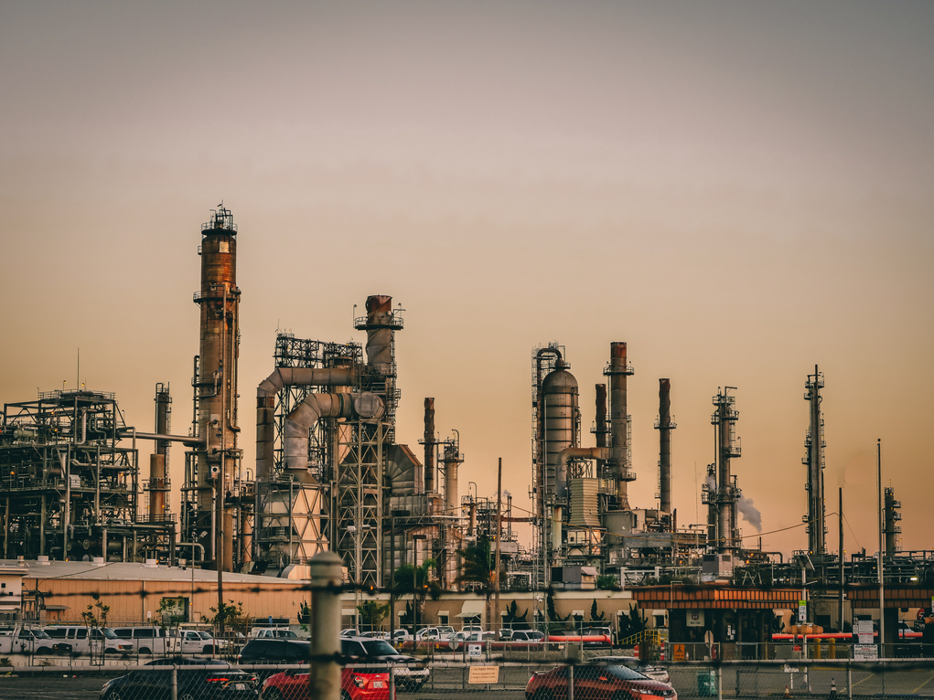

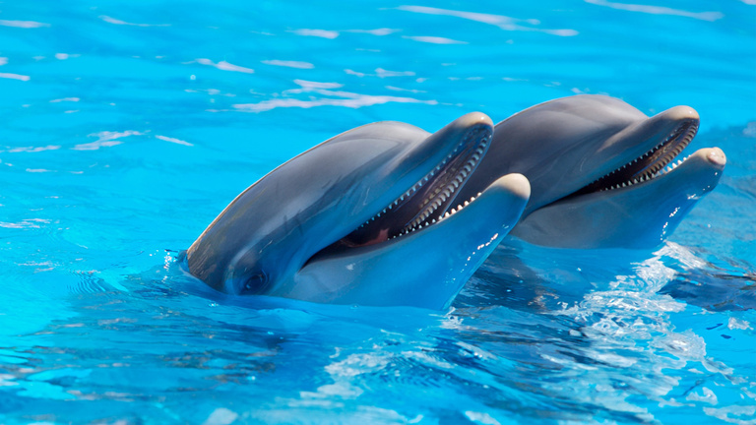

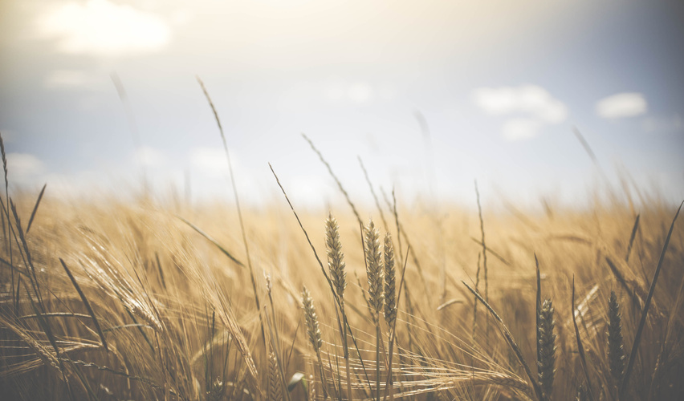
Co-beneficts
Fuel
Health
Agronomy
Animals
Nutritional science
The development of biomass with the potential to be used as biodiesel
Improvement of the health of workers or people around the photobioreactors
Research and development of fertilizers for use in plant and crop cultivation
Conversion of the biomass into food for aquatic animals
Creation of food complements from the biomass due to the amount of vitamins and proteins

Slide 10


Opportunity areas
Emerging High-Value Markets
Supportive Government Frameworks
Agricultural Sector Diversification

Slide 11
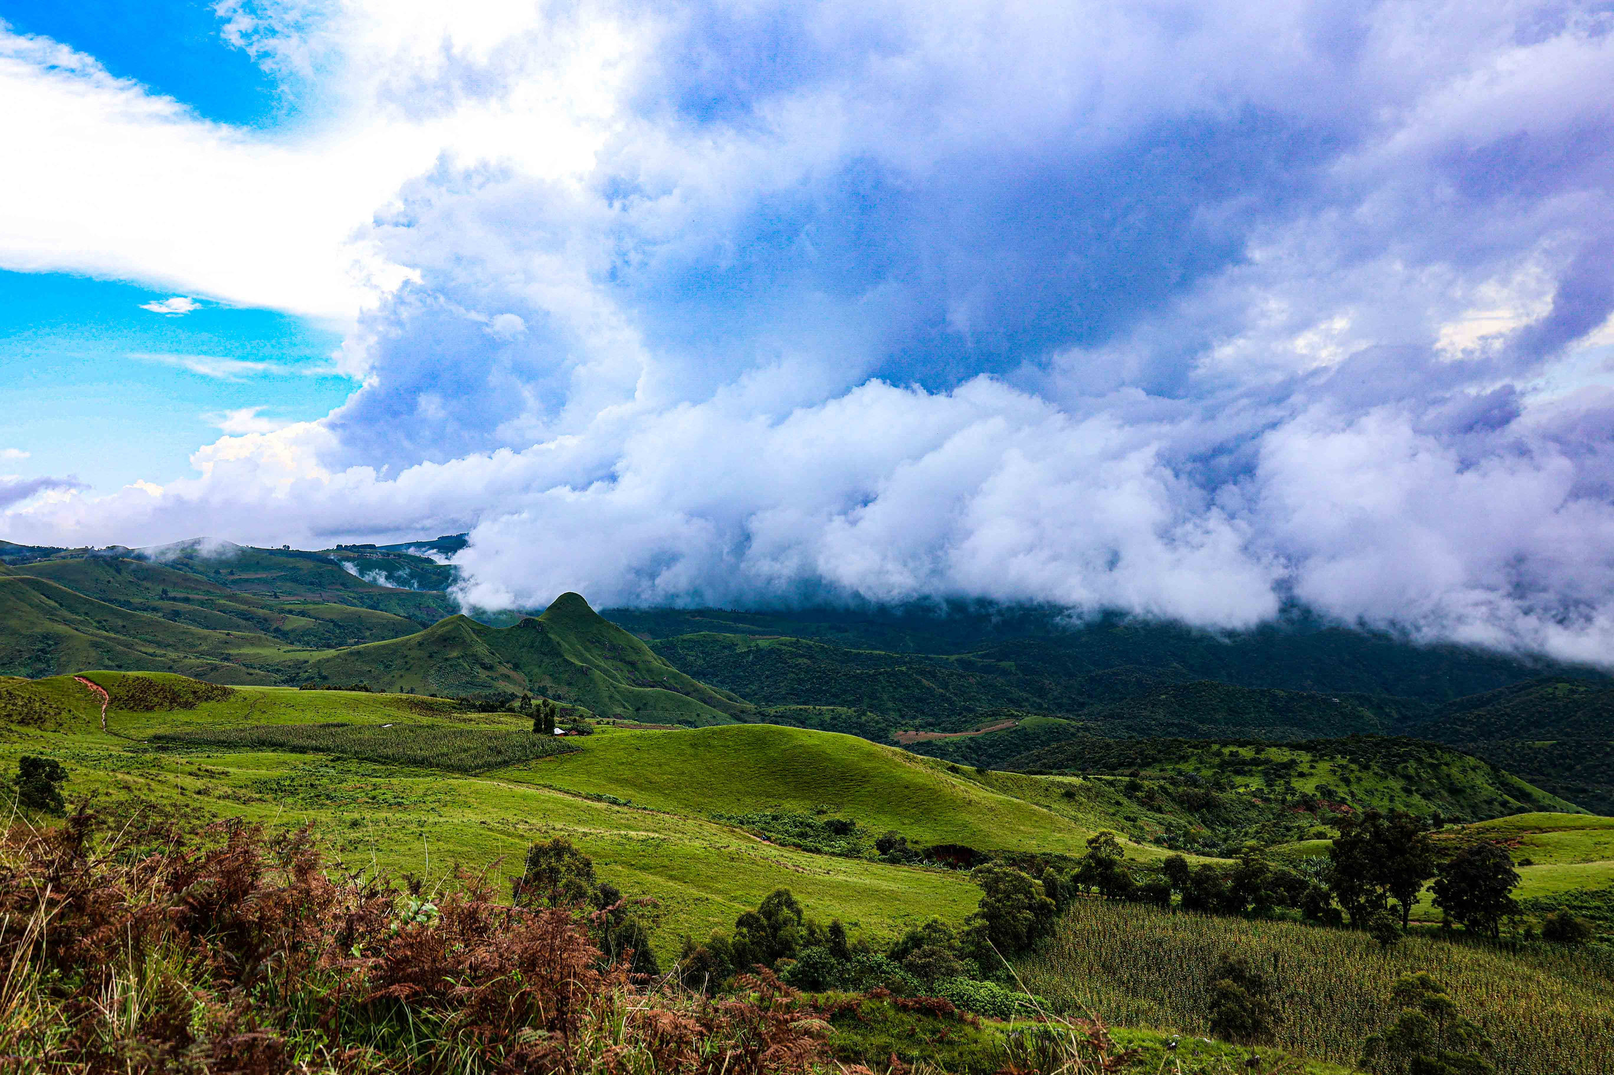
Potencial roadblock
Market Price Volatility and Competitive Landscape
Climate-Related Operational Risks

Slide 12
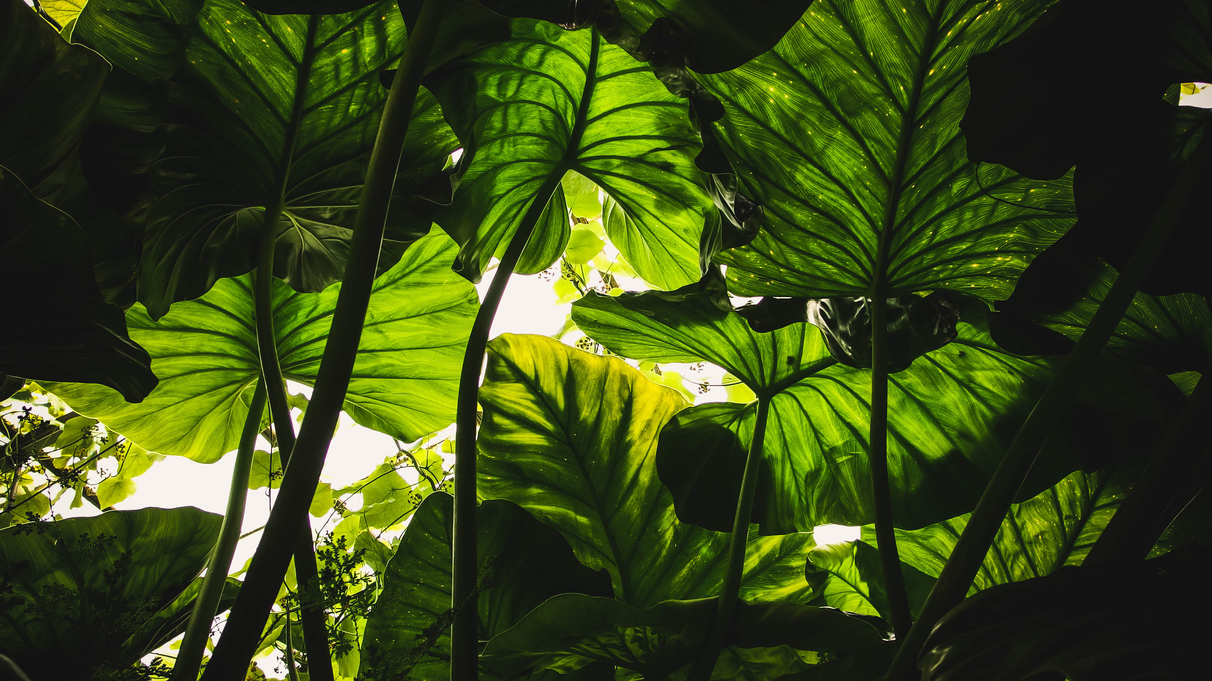
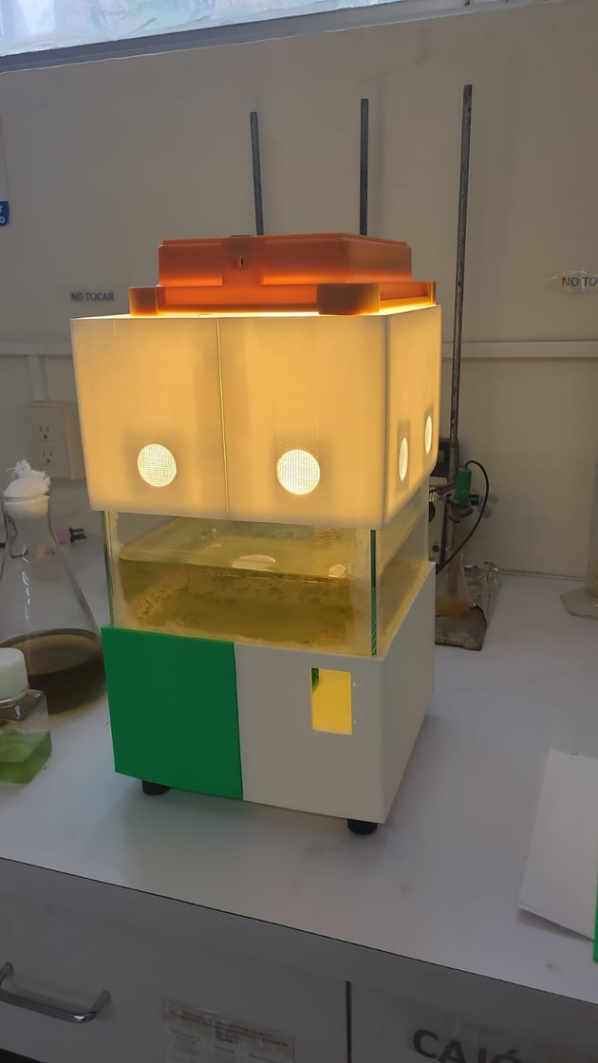
Status of the project
The completion of the first functional photobioreactor prototype
Scheduling meeting with new potential business partners
Image of the photobioreactor

Slide 13
Future work
Improve our networking to present this initiative to new companies or business partners.
Implement and make this project a reality inside our alliances.
Implementation in Mexico to complete our compromise in the Treaty of Paris

Slide 14

Thanks!!
Communicate with us
to make the world green
danylinan74@gmail.com
luisgsouber@hotmail.com

