Slide 1

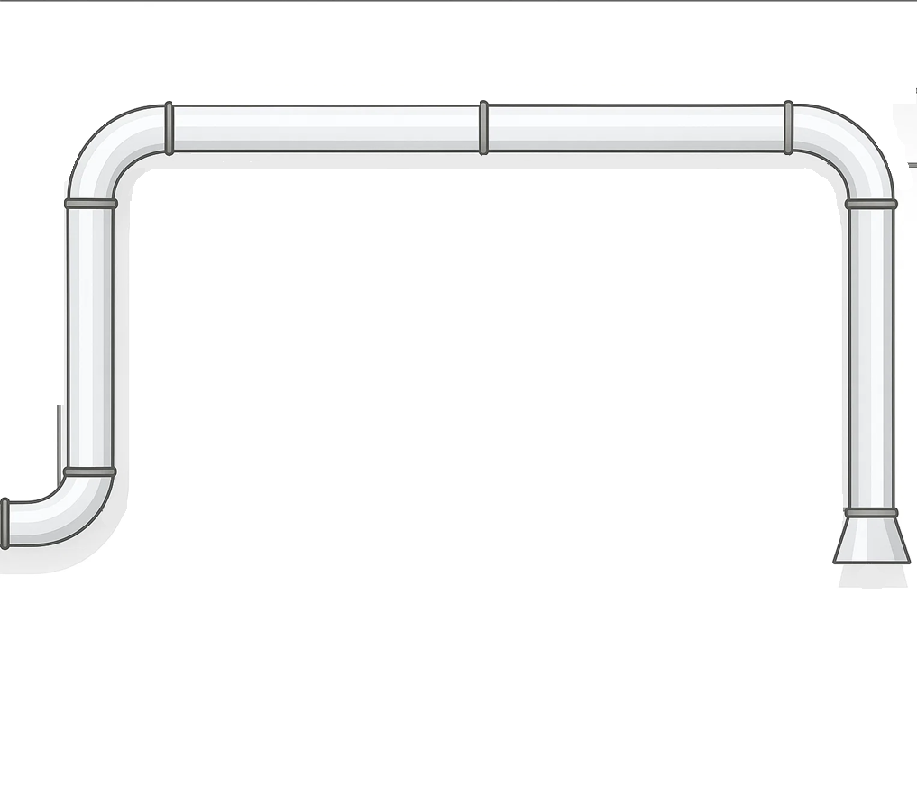


Zoetis Carbon Reduction Challenge
Reduce carbon emissions and energy use in Atlanta Zoetis cleanrooms by lowering airflow during off-hours.

Slide 2
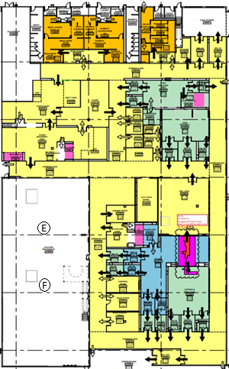
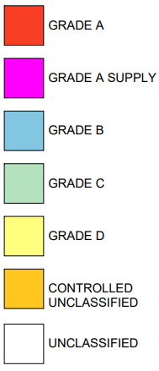
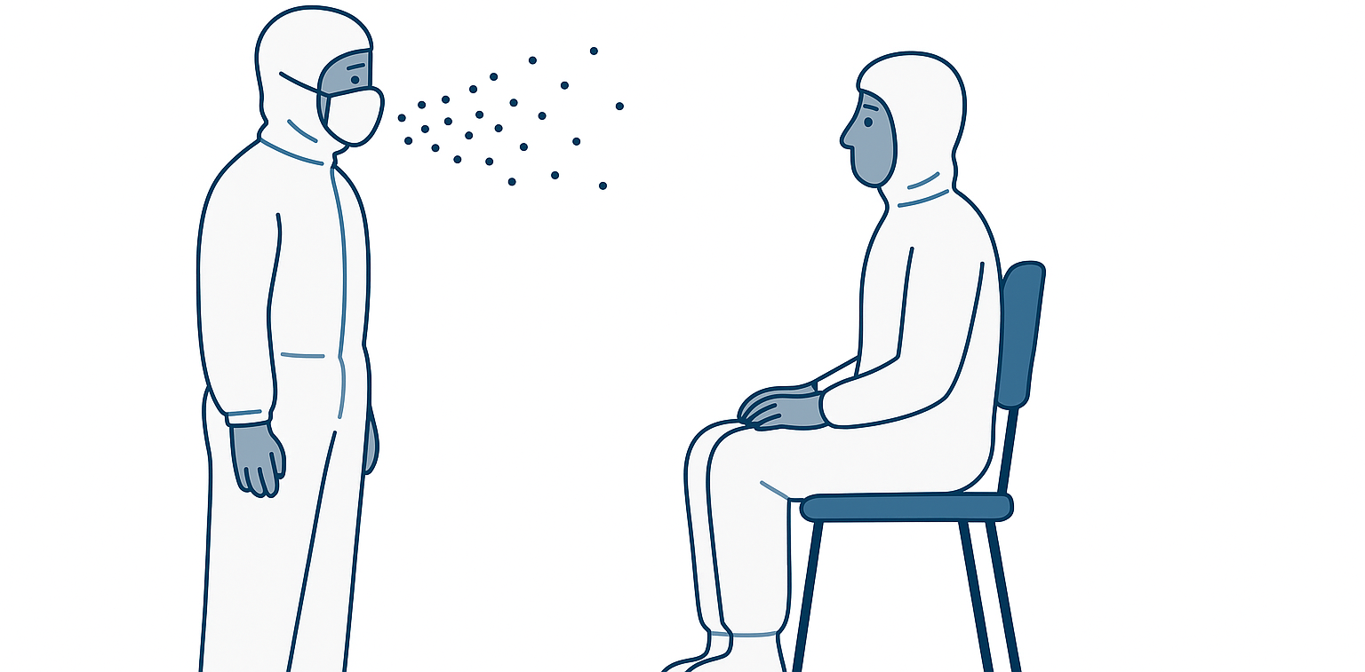
Background and Motivation
People drive particles
At Rest = Less Particles
Facility Map

Slide 3

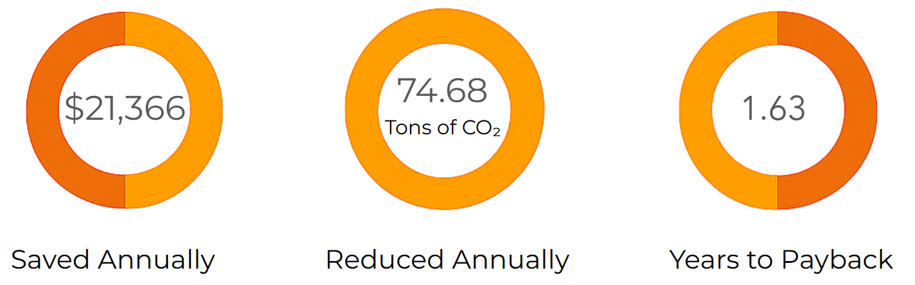
Carbon Reductions and Cost Savings
Annual CO2 Savings vs. % Reduction in Air Changes per Hour
Net Present Value Accumulation Over Time

Slide 4
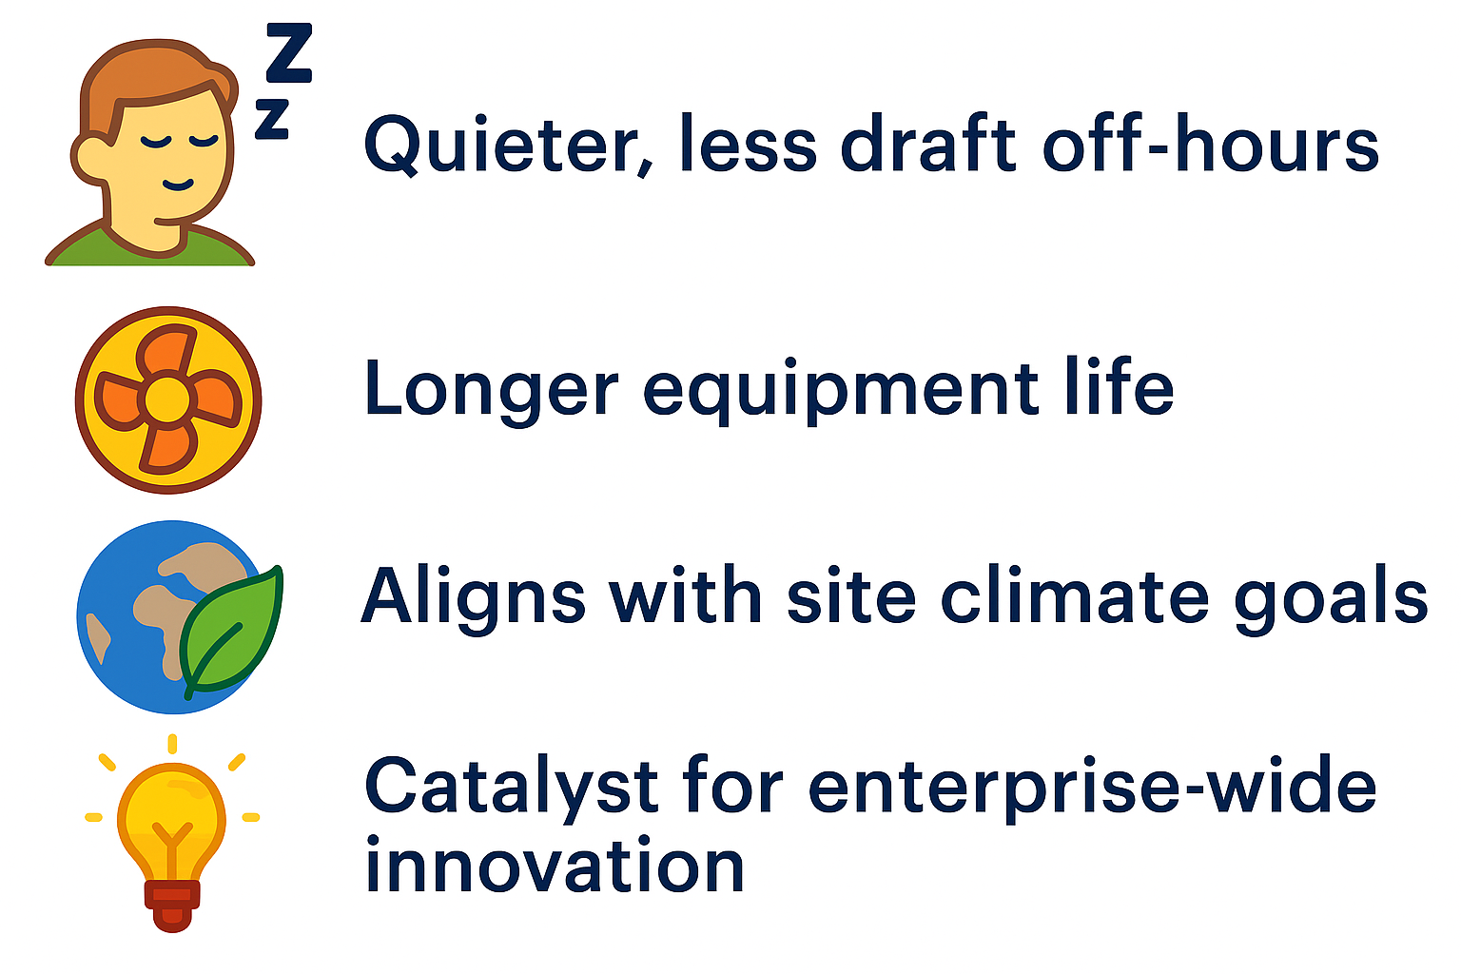
Co-benefits

Slide 5
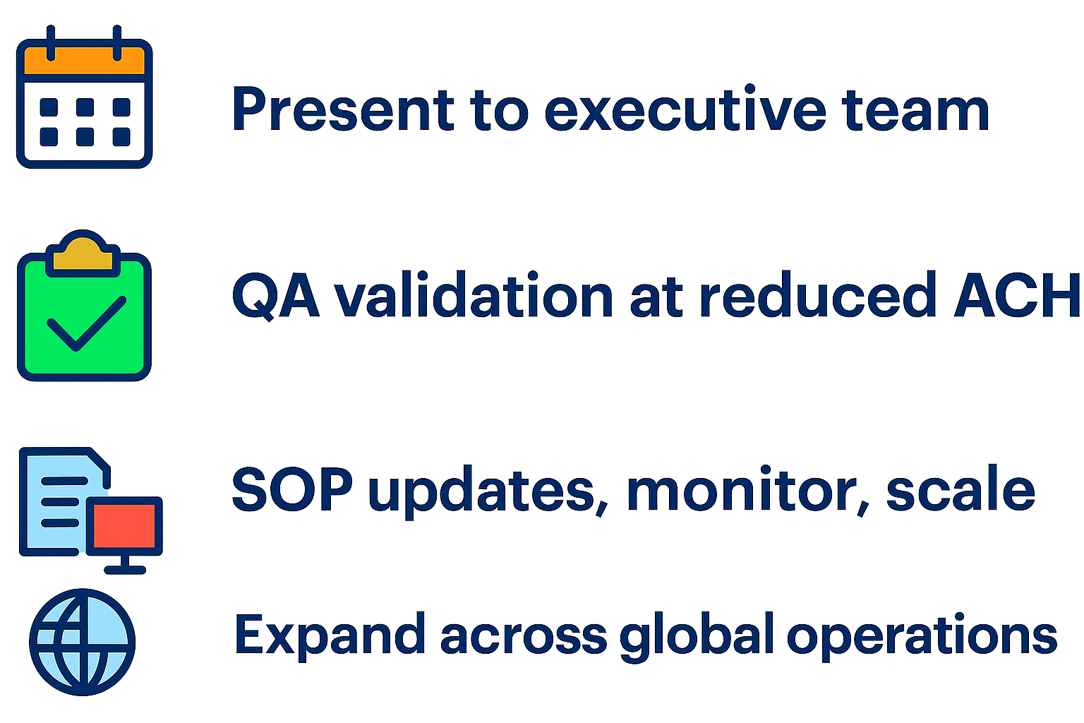
Next Steps
Present to Executive Team
QA validation at reduced ACH
SOP updates
Expand across global operations

