Slide 1
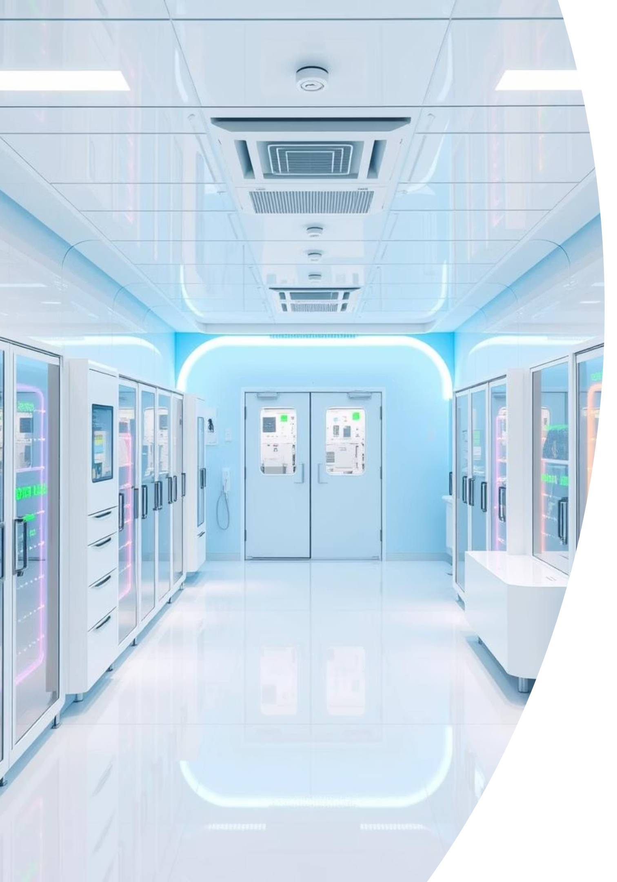




Green Cleanroom: Turning cleanrooms from energy hogs into energy heroes
Presented by:
Sara Abdallah: s-sara.shehata@zewailcity.edu.eg
Adham Mohamed: s-adham.ibrahim@zewailcity.edu.eg
Supervised by:
Dr. Yasmine ElOgail: yelogail@zewailcity.edu.eg

Slide 2
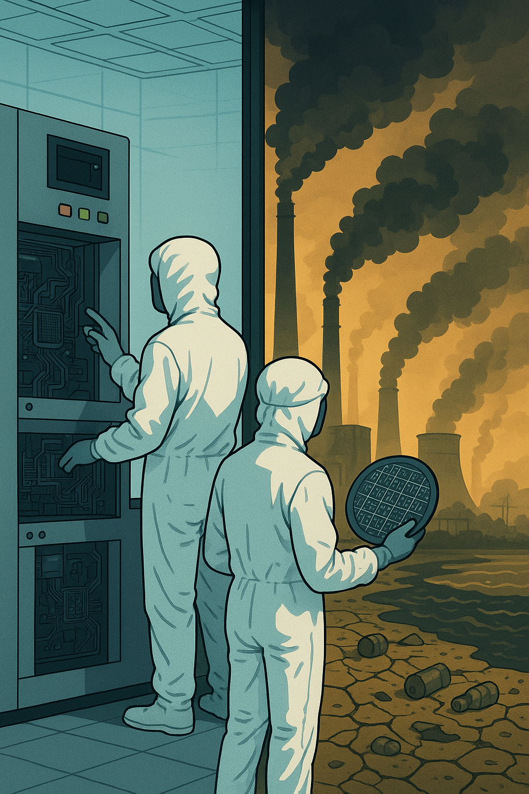
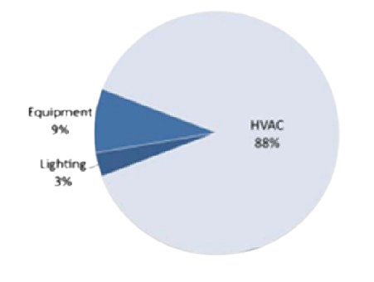
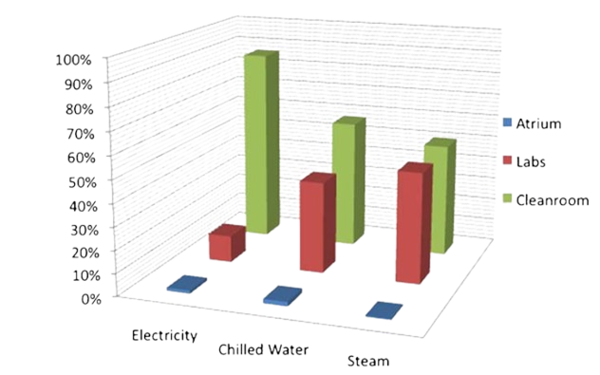
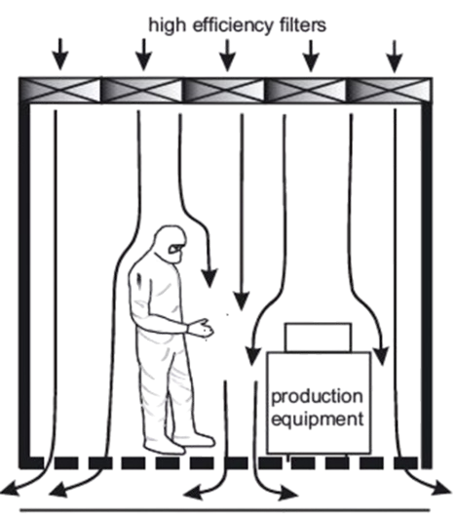
Why Focus on Cleanrooms?
Cleanrooms are vital for tech and pharma, but they're energy hogs!
They use 10-100x more energy than regular offices.
HVAC systems run 24/7, sucking up 50-75% of the energy.
Improving cleanroom efficiency is a high-impact way to cut emissions and costs without compromising performance, aligning with global sustainability goals.

Slide 3

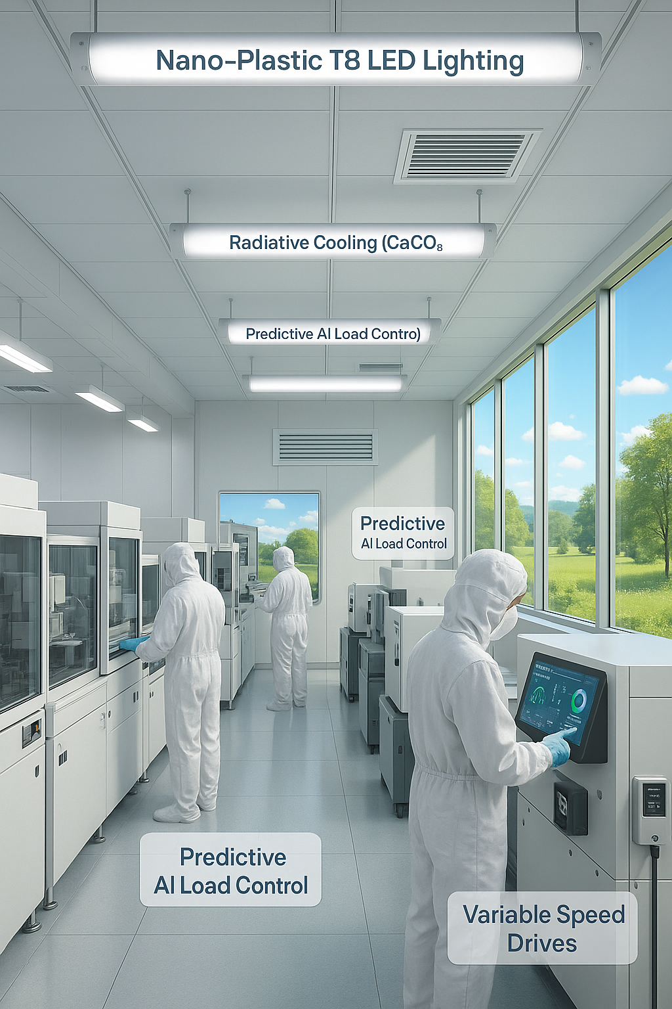




Our 4-in-1 Green Cleanroom Strategy
Our project aims to reduce carbon emissions and operational energy costs in cleanroom environments through scalable, high-impact engineering interventions. This strategy focuses on innovating smart, scalable solutions that cut emissions without compromising performance.
Predictive AI Load Control
Radiative Cooling
Integrate smart algorithms to optimize HVAC, filtration, and lighting in real time based on demand.
Utilize ultra-white CaCO₃ paint as a passive rooftop coating to reduce heat gain and HVAC energy load.
Variable Speed Drives (VSDs)
Nano-Plastic T8 LED Lighting
Retrofit vacuum pumps with VSDs to dynamically adjust power consumption based on operational needs.
Replace existing lighting with highly efficient, long-life LED tubes, reducing electricity consumption.

Slide 4
Our 4-in-1 Green Cleanroom Strategy
Our project aims to reduce carbon emissions and operational energy costs in cleanroom environments through scalable, high-impact engineering interventions. This strategy focuses on innovating smart, scalable solutions that cut emissions without compromising performance.
Predictive AI Load Control
Radiative Cooling
Integrate smart algorithms to optimize HVAC, filtration, and lighting in real time based on demand.
Utilize ultra-white CaCO₃ paint as a passive rooftop coating to reduce heat gain and HVAC energy load.
Variable Speed Drives (VSDs)
Nano-Plastic T8 LED Lighting
Retrofit vacuum pumps with VSDs to dynamically adjust power consumption based on operational needs.
Replace existing lighting with highly efficient, long-life LED tubes, reducing electricity consumption.

Slide 5
Our 4-in-1 Green Cleanroom Strategy
Our project aims to reduce carbon emissions and operational energy costs in cleanroom environments through scalable, high-impact engineering interventions. This strategy focuses on innovating smart, scalable solutions that cut emissions without compromising performance.
Predictive AI Load Control
Radiative Cooling
Integrate smart algorithms to optimize HVAC, filtration, and lighting in real time based on demand.
Utilize ultra-white CaCO₃ paint as a passive rooftop coating to reduce heat gain and HVAC energy load.
Variable Speed Drives (VSDs)
Nano-Plastic T8 LED Lighting
Retrofit vacuum pumps with VSDs to dynamically adjust power consumption based on operational needs.
Replace existing lighting with highly efficient, long-life LED tubes, reducing electricity consumption.

Slide 6
Our 4-in-1 Green Cleanroom Strategy
Our project aims to reduce carbon emissions and operational energy costs in cleanroom environments through scalable, high-impact engineering interventions. This strategy focuses on innovating smart, scalable solutions that cut emissions without compromising performance.
Predictive AI Load Control
Radiative Cooling
Integrate smart algorithms to optimize HVAC, filtration, and lighting in real time based on demand.
Utilize ultra-white CaCO₃ paint as a passive rooftop coating to reduce heat gain and HVAC energy load.
Variable Speed Drives (VSDs)
Nano-Plastic T8 LED Lighting
Retrofit vacuum pumps with VSDs to dynamically adjust power consumption based on operational needs.
Replace existing lighting with highly efficient, long-life LED tubes, reducing electricity consumption.

Slide 7
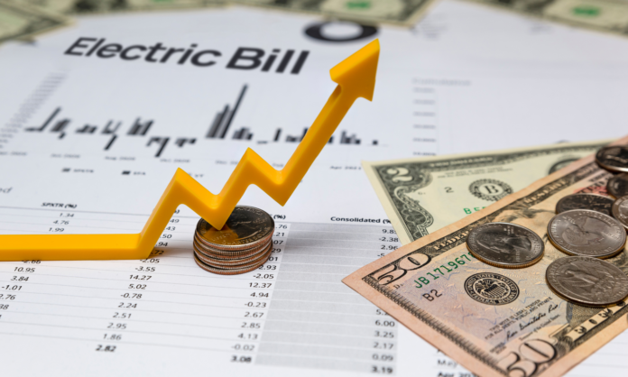
$37,600
Initial investment $
Carbon Reduction & Cost Savings
120-165
356K
Metric Tons of CO₂/Year
kWh/Year Energy Savings
Estimated annual carbon reduction, replacing over 356,000 kWh of grid electricity with renewables.
Total annual energy savings, leading to significant cost reductions.
Strategy
AI Predictive Control System
CaCO₃ Radiative Coating
VSDs for Vacuum Pumps
Nano-PlasT8 LED Lighting
Total
Initial Investment (USD)
36,000
472
1000
135
Annual Savings (USD/year)
14,500-20,300
103
700
77
Carbon Savings (Metric Tons/Year)
113-158
0.8
5.4
0.66
$21,180
$85,574
Annual Cost Savings
Net Present Value (NPV)
Financial benefits from reduced energy consumption and optimized operations.
Projected long-term financial gain from the implemented solutions.
57.36%
1.72
$37,600
15,380-21,180
120-165
Internal Rate of Return (IRR)
Years Payback Period
High return on investment, indicating strong financial viability.
Rapid return on initial investment, showcasing financial efficiency.

Slide 8
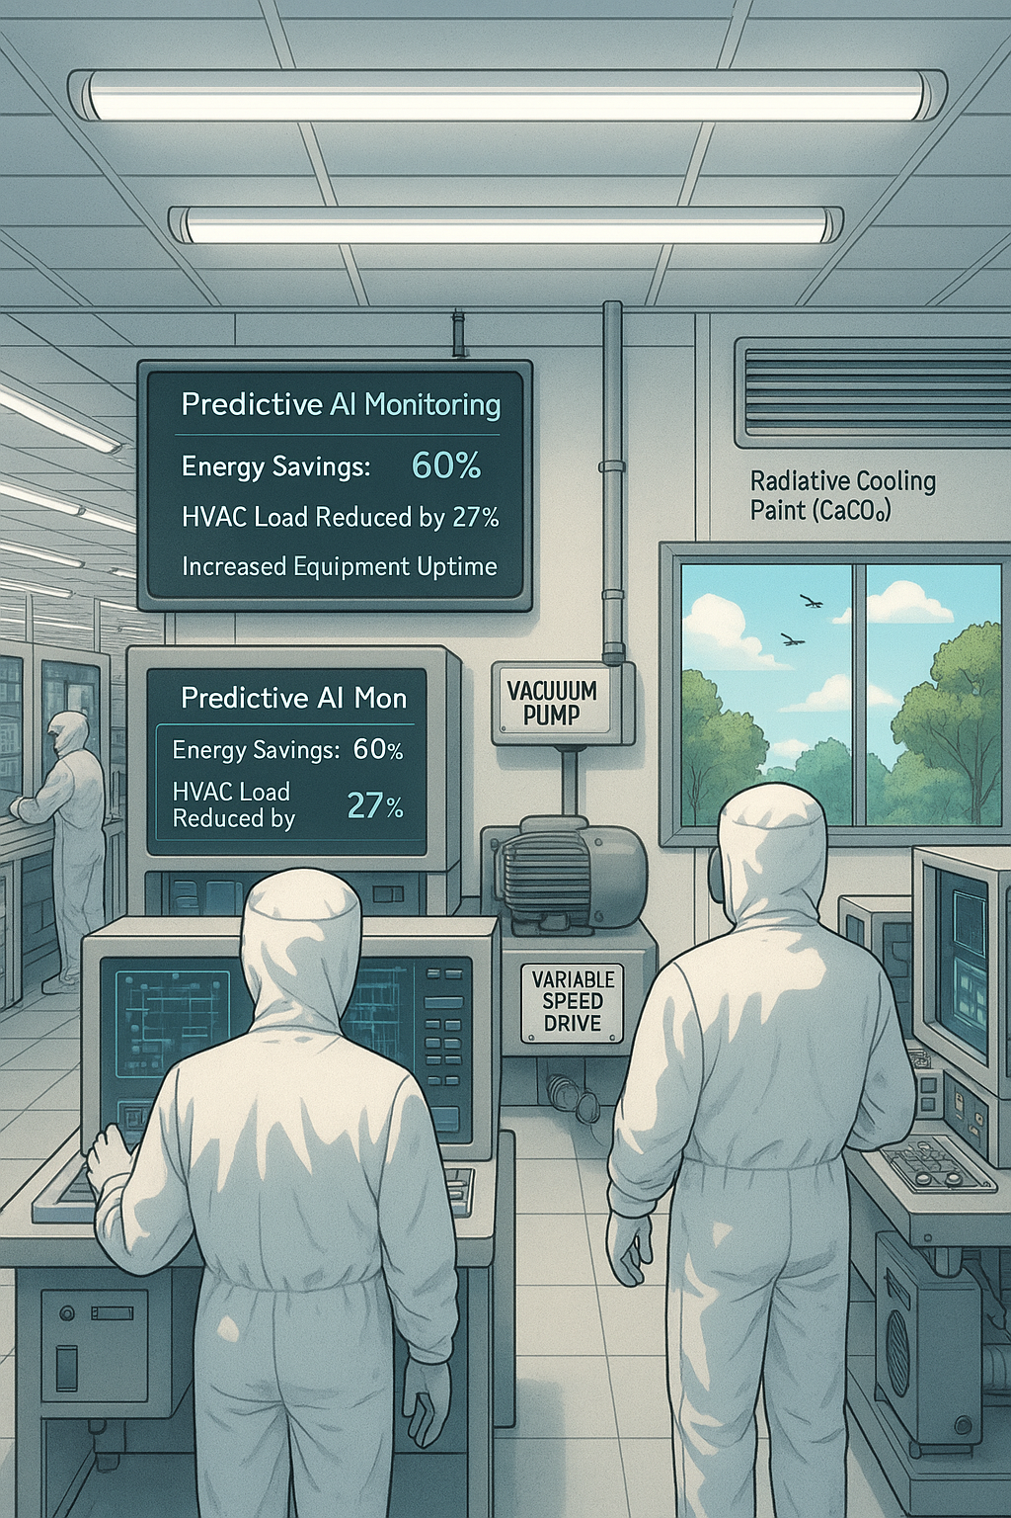
Co-benefits & Next Steps
Our green cleanroom strategy extends beyond direct energy and carbon savings, offering a range of valuable co-benefits and a clear path forward.
Enhanced Reliability & Efficiency
Real-time monitoring and predictive maintenance.
Lower internal temperatures, reducing HVAC load, improving comfort and roof lifespan.
Energy savings of 40–60%, reduced noise, longer equipment life.
Improved visibility, reduced eye strain, and lower waste for environmental and public health.
Next Critical Steps
Current Phase: Proposal and feasibility assessment
Engagement: Present proposal to Zewail City's facilities management.
Alignment: Seek formal approval from senior management and key decision maker.
Goal: Implement a replicable model for carbon in cleanroom environments.

Slide 9
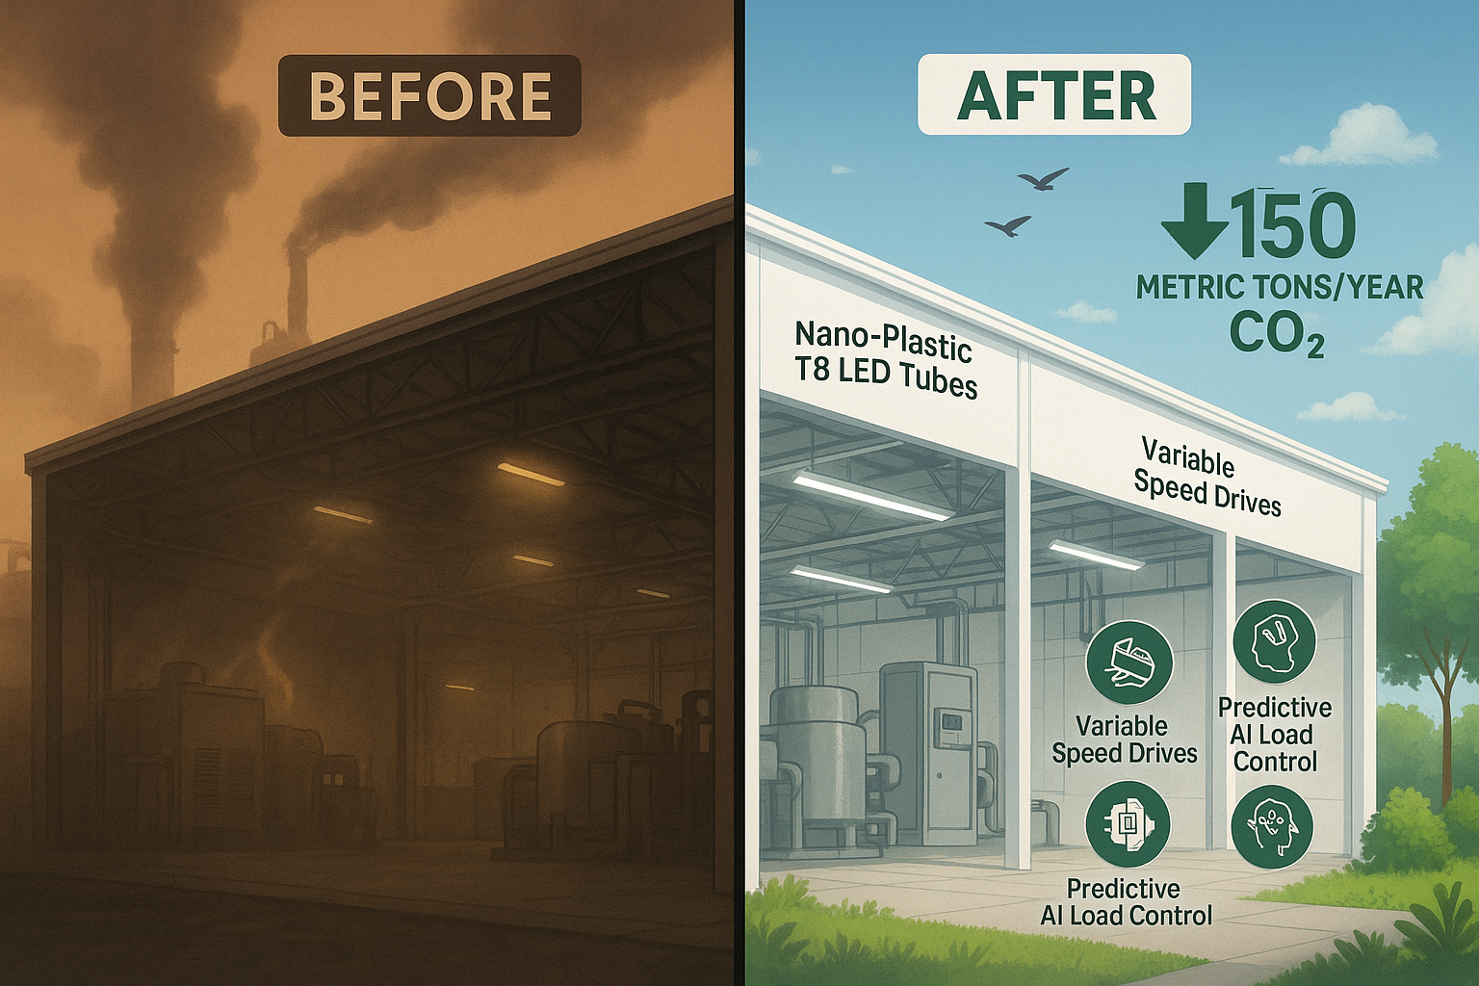
Summary:
Our project aims to reduce carbon emissions in cleanroom facilities by implementing innovative, low-cost, and scalable engineering solutions tailored for high-tech environments like Zewail City.
Key Interventions:
Projected Impact:
Radiative Cooling Paint: Ultra-white CaCO₃ for reduced heat absorption.
Variable Speed Drives (VSDs): For optimized vacuum pump energy use.
Predictive AI Load Control: To optimize HVAC and lighting operations.
Nano-Plastic T8 LED Tubes: High-efficiency lighting replacement.
Achieve payback periods under 2 years.
This initiative provides a replicable model for carbon reduction across academic and industrial settings, fostering sustainable cleanroom environments.

