Slide 1
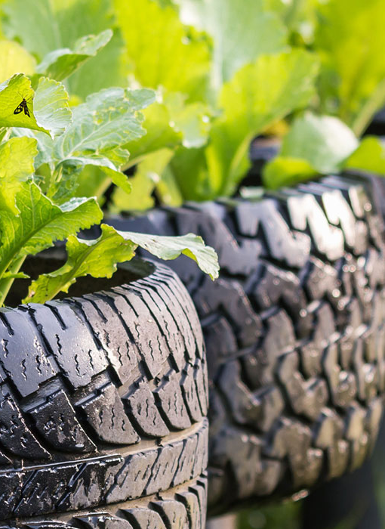

Tire Recycling Initiative
By: Aneesh Gupta and Ansley Fox
Carbon Reduction Challenge Summer 2025

Slide 2

Our Task

Slide 3
Create a Tire Recycling Initiative for Tucker, GA!
→
About Tucker:
Population of about 35,000
Became a city November 2015
Relies on DeKalb County for public services, water, and sanitation
Tucker’s Advice for Us:
Utilize GA EPD funding to create a tire amnesty event
Tire Amnesty Event: an event on city property where residents can bring used tires for free and all transportation and processing will be paid for

Slide 4
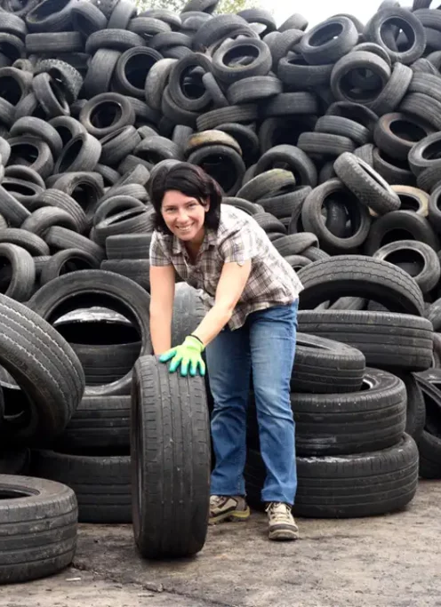
What we discovered
30/30 of the Tucker Residents we interviewed said they dispose of their tires through a company
Which led us to discover: Georgia Law bans whole tires from being sent to the landfill
The residents were not going to be our target!
Notes:
Whole tires can’t be sent to the landfill because… In fact, currently 48 states have legislation on scrap tires, with 38 of them banned from landfills in whole form

Slide 5
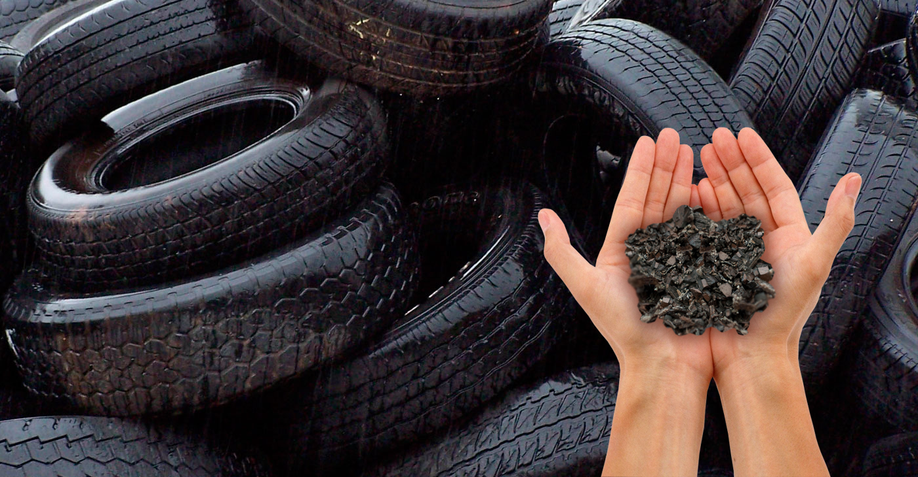
So, We Changed Direction
and researched local tire businesses
Out of the 8 tire businesses we went to, 5 gave us their information
All employ processors that claim to process tires in an environmentally friendly way (ex. Hero Tires, Liberty Tires, Trade Your Tires)
What does it mean to ”process” tires?
Shred tires to be sent to the landfill (takes ~50-80 years to decompose)
Shred tires to be sold to another business to reuse (ex. Lehigh Technologies)
Transformed into Tire-Derived Fuel (TDF) which is a sustainable alternative to fossil fuel
TDF produces about 25% more energy than an equivalent amount of coal

Slide 6
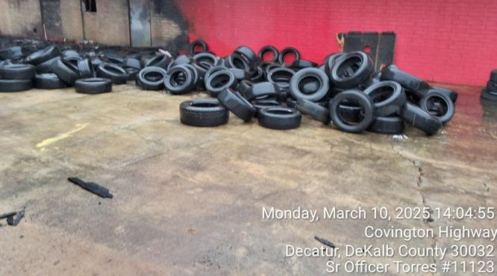
The Real Problem: Illegal Tire Dumping
NOTABLE NEWS
Tire processors want to avoid paying the processing fee they charge customers for
In 2010, GA estimated about 11% of scrap tires were illegally dumped
Dekalb County is no stranger: 19 counts of illegal dumping since Jan 1 of this year
June 2025:
3 arrested in response to illegal tire dumping
Hundreds of tires dumped outside of a pre school
Staffers at preschool believe clean up has been ”too slow”
December 2017:
20,000 tires were found in Fork Creek Mountain Park
Led to a cleanup crew between 6 county departments
→

Slide 7
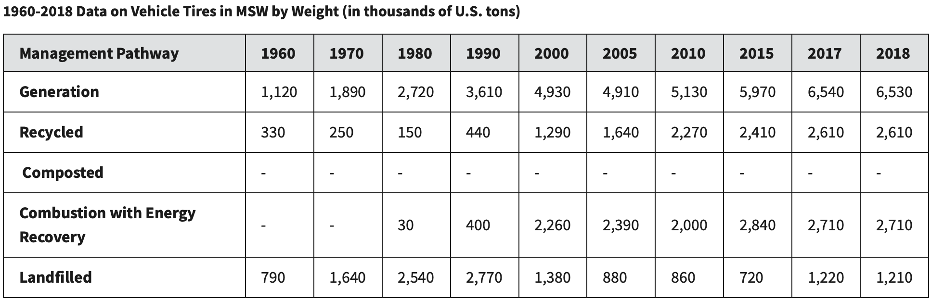
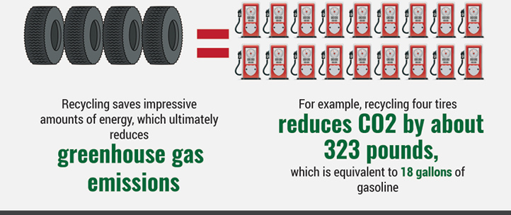
How Big Is This Problem?
Source: EPA
In 2018, about 18% of tires were sent to the landfill, an improvement since the 71% in 1960
Tires are combusted or recycled in roughly equivalent amounts
One tire produces about 81 pounds of CO2, equivalent to 4.5 gallons of gasoline
→
Source: recycledrubberfacts.org

Slide 8
What Should We Do?
↓
Collect More Data
Accountability system for tire companies
Scale Up Investigation from DKPD
Proper accountability for local tire companies to add an incentive to stick to what they advertise.
Create larger efforts to proactively prevent illegal tire dumping rather than reactively.
The most recent data from the EPA dates back to 2018, with the most in depth data coming from 2003
Improve Media Coverage
A quick google search only yields a few incidents of illegal tire dumping. With 19 incidents in the span of a few months, we need more news articles being released on each incident to better inform the public.
Notes:
Don’t read this slide word for word!! Summarize!!

Slide 9



Thank you!
Aneesh Gupta
agupta3044@gatech.edu
Ansley Fox
ansley.fox@uga.edu

Slide 10
Sources
https://eco-act.org/wp-content/uploads/2014/04/T.I.R.E.D-small.pdf
https://www.wsbtv.com/news/local/dekalb-county/3-arrested-dekalb-county-illegal-tire-dumping-cases-including-front-pre-school/XP7O2CFZG5AVBAM3YQ23WKAKHM/
https://www.epa.gov/facts-and-figures-about-materials-waste-and-recycling/durable-goods-product-specific-data
https://www.metrorecycling.net/post/tires-in-landfills
https://archive.epa.gov/epawaste/conserve/materials/tires/web/html/basic.html
https://www.dekalbcountyga.gov/news/dekalb-cleans-illegal-tire-dump-site
https://www.fox5atlanta.com/news/illegal-tire-dumping-dekalb-county-3-people-arrested
https://www.decaturish.com/news/dekalb/dekalb-county-investigates-illegal-tire-dumping-asks-for-the-public-s-help/article_277438aa-0aa3-50e9-a044-cf7b19ee9262.html
↑

