Slide 1

CARBON REDUCTION
CHALLENGE
Notes:
A. What is the CRC?
The Carbon Reduction Challenge is a semester long competition that empowers students to become part of the climate change solution
We ask students who hold internships and co-ops to design projects that reduce CO2 emissions while delivering cost savings to their employers.

Slide 2
Making the business case
  Making the financial calculations that show what the benefits of undertaking this project are for your organization and stakeholders
  Important for all firms, both “for-profit” firms and “non-profit” firms!

Slide 3
Examples of Carbon Reduction Commitments
Delta: Expect to invest $1 billion on airline carbon neutrality solutions and expect Sustainable aviation fuel (SAF) will play a key role in the decarbonization pathway
Cox Enterprises: Goals are to send zero waste to landfill by 2024, and to be carbon and water neutral by 2034. Plan on investing more than $100 million in sustainability
Interface: Will be carbon neutral by 2040—that is, store more carbon in their products than they emit

Slide 4
Categories of Carbon Reduction Projects
  Inspire collective change in personal behavior
e.g., red meat challenge, #biketowork, cool water wash, etc.
    Shave energy use through no-cost modifications
e.g., lighting schedule, HVAC/boiler set points, etc.
Make infrastructure change to building’s energy use
e.g., cool roof, recycling equipment, LED bulbs, etc.
Make changes to business model or operations
e.g., sell more fountain drinks instead of single-use drinks, change restaurant menu to have Meatless Mondays, reduce express delivery frequency

Slide 5
Making the business case
  Quantifying the financial benefits
    Net Present Value, NPV
    Internal Rate of Return, IRR
    Payback period
    Articulating co-benefits
    Increased employee engagement, productivity, retention, etc.
    Better community relations
    Stronger brand recognition and customer loyalty

Slide 6
Making the business case
  Example: LED retrofit
  Number of Fixtures = 500
  Cost per Installed Fixture= $700
  Total investment = 500 x $700 = $350,000 (outflow to firm)
  Savings per year (Energy) = 665,000 kWh
  Energy price = $0.15/kWh
  Savings per year ($) = 665,000 x $0.15 = $99,750 (inflow to firm pre-tax!)
  Plus depreciation tax shield (more later on this)
  LED life = 10 years

Slide 7
Making the business case: NPV
0 | 1
=-100 | $115
  Net present value is the value of the project in today’s dollars:
  NPV = -CF₀ + CF₁/(1+r)¹ + ….CF_{T}/(1+r)^{T}
  Simple example: Suppose you will only invest if you earn 10%. NPV = -100 + $115/(1.1)¹
  NPV = -100 + $104.55 = $4.55
  If what you think the project is worth in today’s dollars (blue) is ≥ the initial investment (yellow), ACCEPT!
  Another way to think about NPV? If NPV >=0, accept!

Slide 8
Making the business case: IRR
0 | 1
=-100 | $115
  Internal Rate of Return (IRR) is the actual yield, or return on the investment. It is also the “r” that makes the NPV = 0
  NPV = -CF₀ + CF₁/(1+r)¹ + ….CF_{T}/(1+r)^{T}
  $0 = -CF₀ + CF₁/(1+r)¹ + ….CF_{T}/(1+r)^{T}
  Forcing the “market price” (the initial investment) to be equal
  to the present value of the project’s CFs
  CF₀ = CF₁/(1+r)¹ + ….CF_{T}/(1+r)^{T}
  100= 115/(1+IRR)¹
  And we are solving for the “r” or interest rate that makes this true
  If IRR is ≥ the WACC, ACCEPT!
  IRR is 15% which >= Firm’s required return of 10% so accept!

Slide 9
Making the business case: Payback
0 | 1
=-100 | $115
  How many years does it take to recover the initial investment?
  This one is pretty easy! Simply take $115/100 = 0.87 years
  (it can sometimes be a tad more complicated than this, but pretty easy always)
  That is, it takes only a portion of one year to “recover” my $100 investment
  By the way, payback does not have a clear-cut decision rule for accept or reject so we must always use this in conjunction with the NPV which is the BEST metric of the three measures.

Slide 10
Making the business case: NPV
0 | 1 | 2….9 | 10
=-350,000 | $99,750 x (1-T) + $35,000 x T | Same CFs Each year | $99,750 x (1-T) + $35,000 x T
  Net present value is the value of the project in today’s dollars:
  NPV = -CF₀ + CF₁/(1+r)¹ + ….CF_{T}/(1+r)^{T}
  We know the cash flows (CF); we do not know
  the “r” or the discount rate ---yet!
  If what you think the project is worth in today’s dollars (blue) is ≥ the initial investment (yellow), ACCEPT!
  We should use the firm’s required return, known as the Weighted average cost of capital (WACC)
  We can easily use Excel for this!

Slide 11
Making the business case: NPV
  Weighted average cost of capital is a “weighted average” of the cost of raising capital from their investors.
  WACC = D/V x R_{D} x (1-T) + E/V x R_{E}
  Two types of investors (on rare occasions, 3 types)
  Firm Debt = $5M Suppose R_{D} = 5% Tax rate = 30%
  Firm Equity = $7M Suppose R_{E} = 8%
  Total Value (V) = $12M
  Solve in Excel!

Slide 12
Making the business case: IRR
  Internal Rate of Return (IRR) is the actual yield, or return on the investment. It is also the “r” that makes the NPV = 0
  NPV = -CF₀ + CF₁/(1+r)¹ + ….CF_{T}/(1+r)^{T}
  $0 = -CF₀ + CF₁/(1+r)¹ + ….CF_{T}/(1+r)^{T}
  Forcing the “market price” (the initial investment) to be equal
  to the present value of the project’s CFs
  CF₀ = CF₁/(1+r)¹ + ….CF_{T}/(1+r)^{T}
  And we are solving for the “r” or interest rate that makes this true
  If IRR is ≥ the WACC, ACCEPT!
  EXCEL again is our friend!

Slide 13
Making the business case: Payback period
  How many years does it take to recover the initial investment?
  Let’s do this in Excel!
  By the way, payback does not have a clear-cut decision rule for accept or reject.
  Now to Excel!

Slide 14
Making the business case: Summary
  The LED retrofit is a financially attractive project, with the following financial profile:
  NPV = $206,641
  accept if NPV ≥ $0
  IRR = 18.88%
  accept if IRR ≥ WACC
  Payback = 4.36 years
  accept/reject rule is arbitrary
  Co-benefits: Decrease in temperature and therefore lower AC needs, better lighting, reduced end-of-life waste since LEDs last much longer

Slide 15
Making the business case: Considerations
Make sure you calculated expected lifetime of the improvement. Need a timeline (and you need this for your financial calculations anyway!)
Make sure you include all costs associated with your project. What is the cost of new materials? Cost to install? Additional costs such as disposal/recycling of old products?
Compare apples and apples
Replacing 20watt incandescent lights with 3watt LEDs
LEDs have a 30,000 hour life vs. incandescent that last 2500 hours, so make sure to factor in 12 cycles of incandescent replacement in cost comparisons and labor cost over lifetime

Slide 16
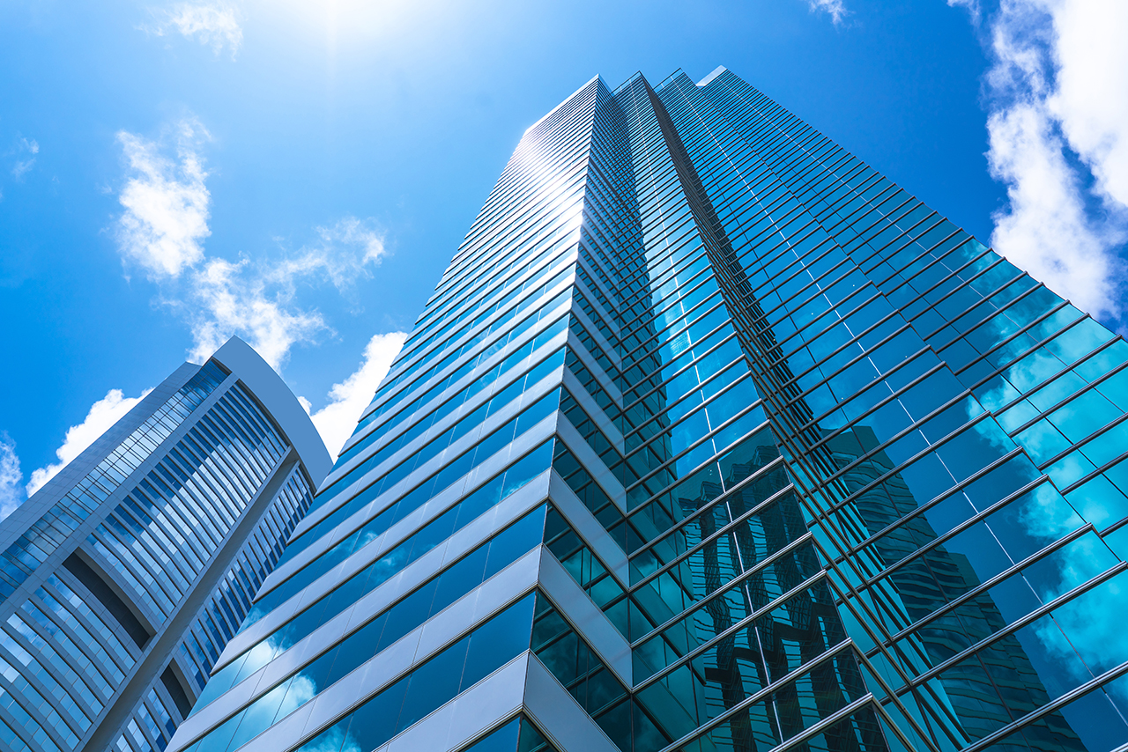
Making the business case: Considerations
Project scope: Turn lights off 30 minutes earlier at end of day in 45-floor building
Project type: No-cost modification project
C02 reduced: 360,000 lbs/year
Investment cost: $0
Annual estimated savings: $24,600 (assume after tax)
NPV at 3% over lease duration: =NPV(3%,24600…24600) = $366K
Co-benefits: increased fixture life and reduced labor and waste

Slide 17
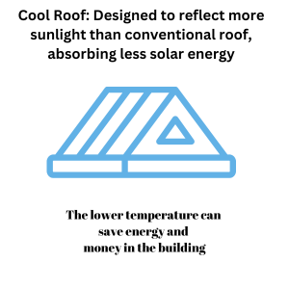
Making the business case: Considerations
Project scope: Install a “cool roof” on Sustainable Education Building
Project type: Infrastructure
C02 reduced: 150,000lbs/year
Investment cost:$49,000
Annual estimated savings: $5,100 (assume after tax)
NPV at 3% over roof life: NPV(0.03,5100….5100)-49,000 = $26,875
IRR: 8.29%
Payback: 9.6 years
Co-benefits: Reduced heat islands on campus

Slide 18
Thank you and
Enjoy your project!
Dr. Jacqueline garner
Georgia Institute of Technology

