Slide 1
Carbon Reduction Challenge
Climate Science Introduction
Summer 2023

Slide 2
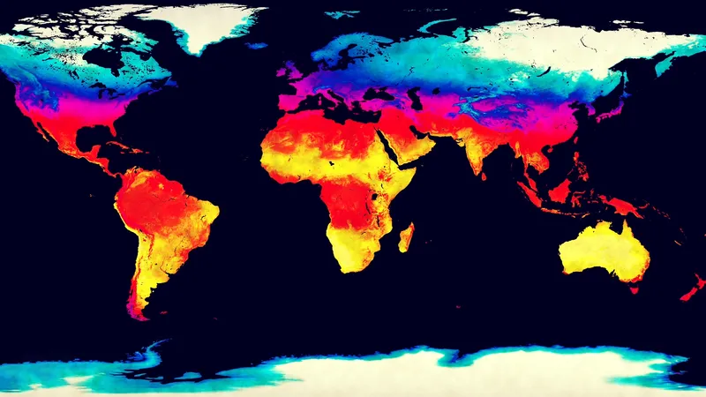

https://www.britannica.com/science/climate-meteorology
Notes:
Intro
Can always email for questions or stop by office hours
**please remember that climate numbers and science are constantly being updated and improves as it is an important topics right now
Climate vs. weather

Slide 3
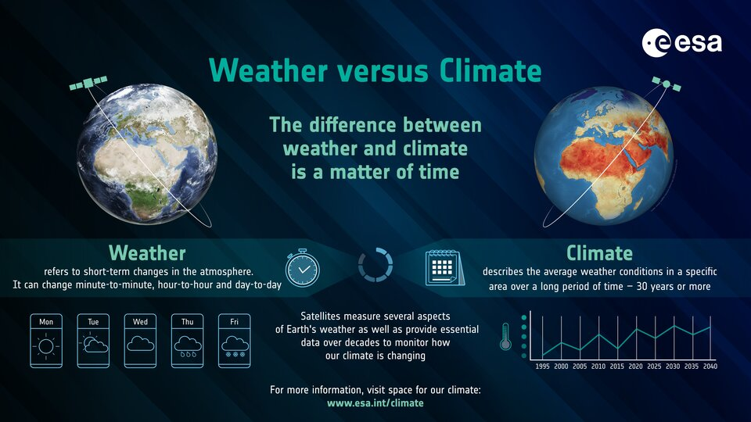

Slide 4
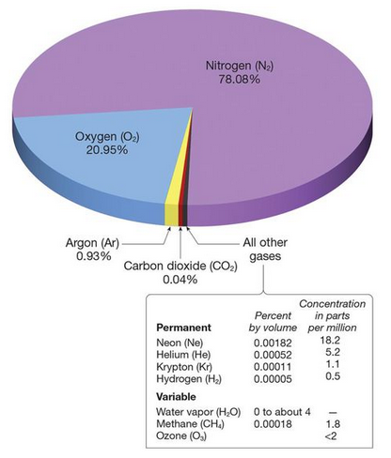
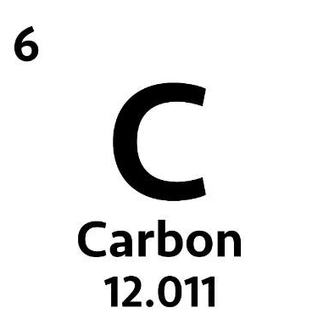

Greenhouse Gases Include:
Water Vapor H₂O
Carbon Dioxide CO₂
Methane CH₄
Nitrous Oxide N₂O
Chlorofluorocarbons
Physical Geography 12e

Slide 5
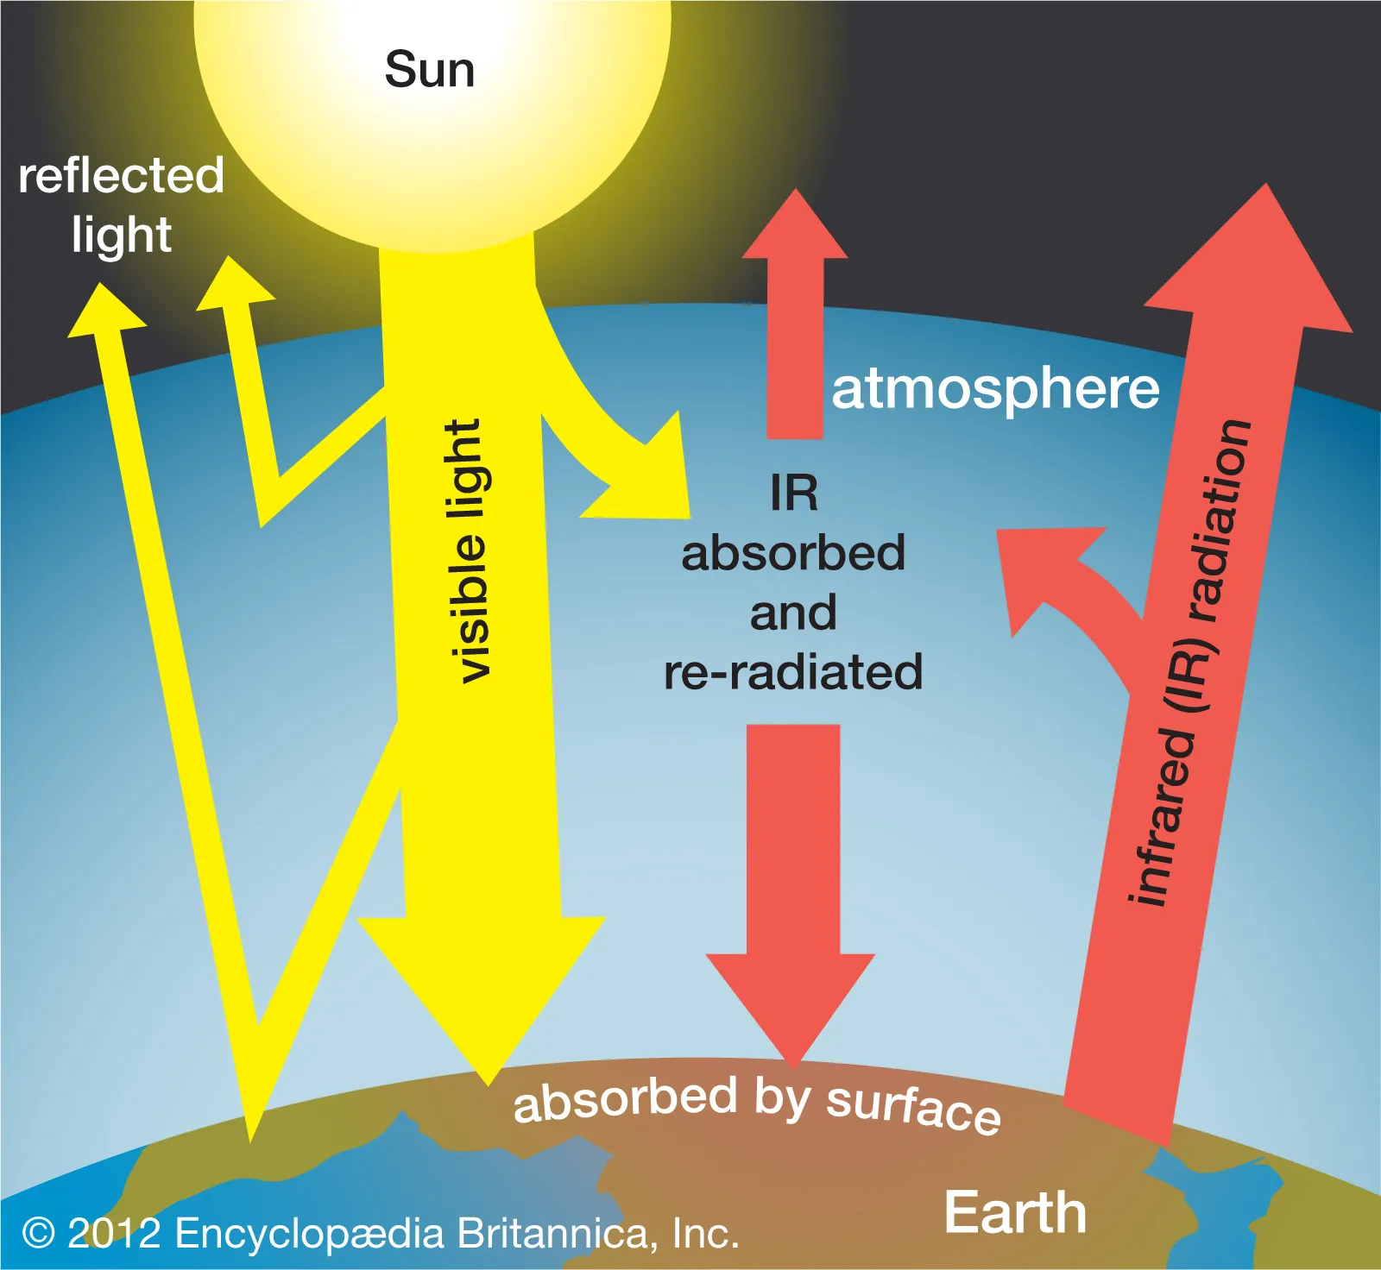
Greenhouse Gas Effect
Greenhouse gases in the atmosphere trap heat, specifically longwave infrared radiation, leaving the Earth.
This is important because without greenhouse gases, the average temperature on Earth would be ~0*F (-18*C)

Slide 6
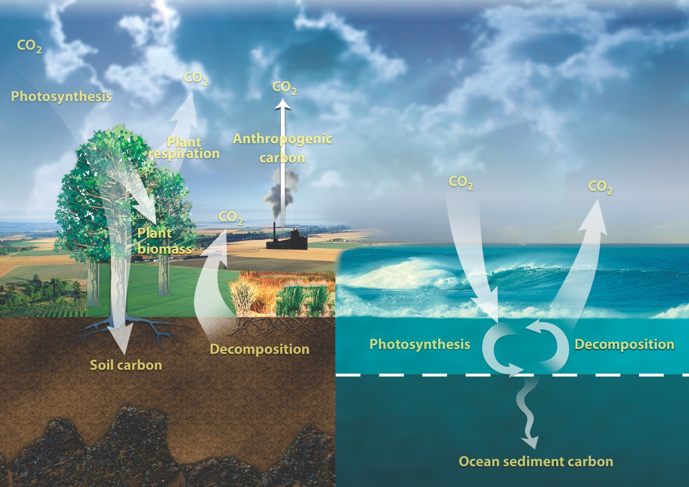
Naturally
https://www.nationalgeographic.org/activity/tracking-down-carbon/
Anthropogenically

Slide 7
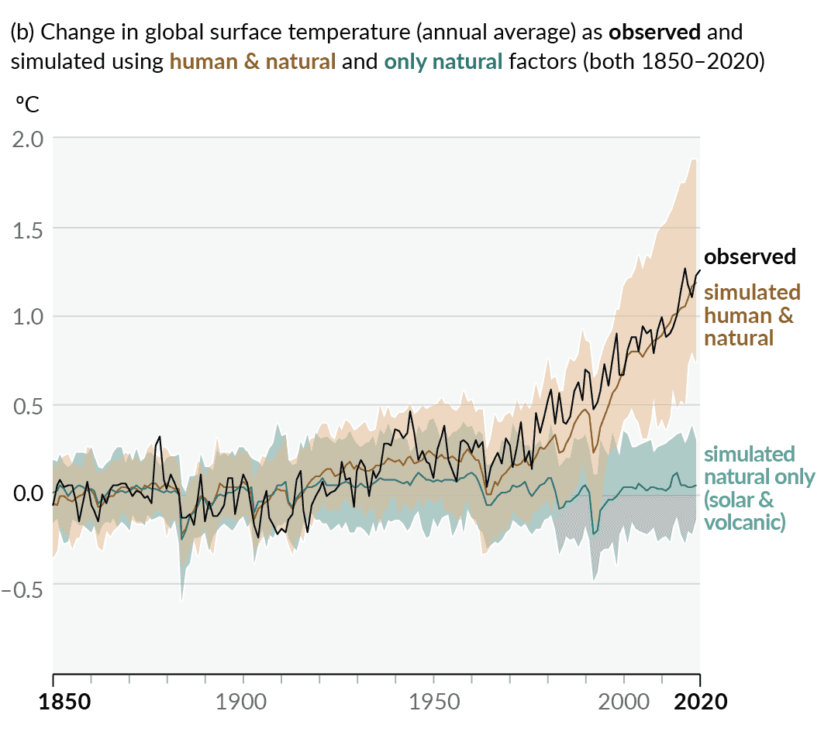

Slide 8
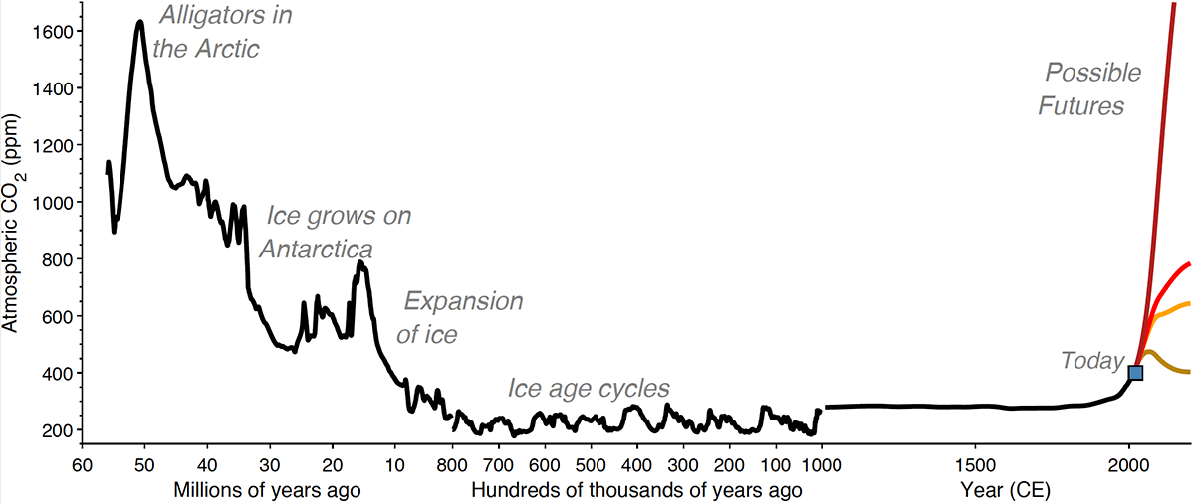
https://today.tamu.edu/2021/06/14/ancient-deepsea-shells-reveal-66-million-years-of-carbon-dioxide-levels/

Slide 9
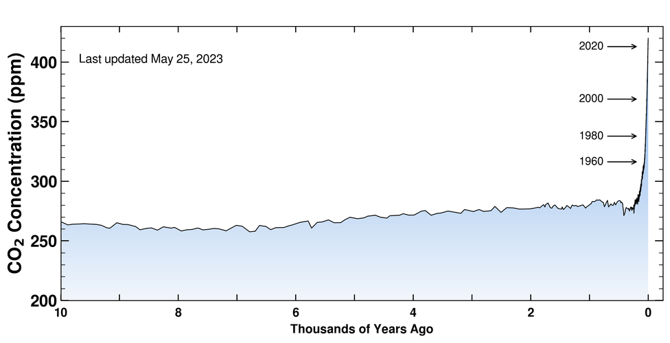
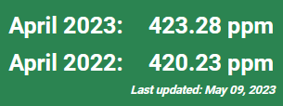
https://keelingcurve.ucsd.edu/
Notes:
And it's been about 315 parts per million when this record began in 1958, and here we are at the 417 going up about 3 parts per million every year.

Slide 10
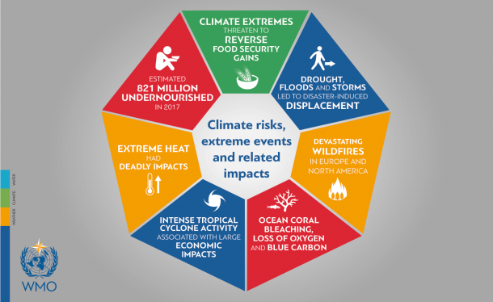

Slide 11
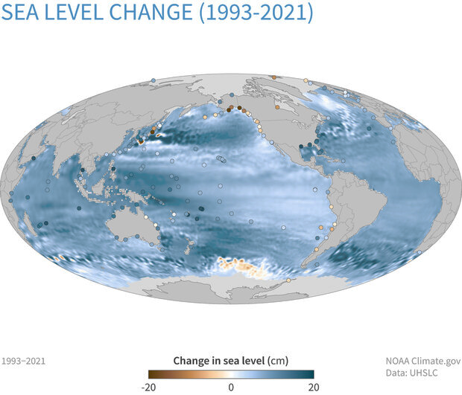
“Global average sea level has risen 8–9 inches (21–24 centimeters) since 1880.”
“In 2021, global sea level set a new record high—97 mm (3.8 inches) above 1993 levels.”
https://www.climate.gov/news-features/understanding-climate/climate-change-global-sea-level

Slide 12
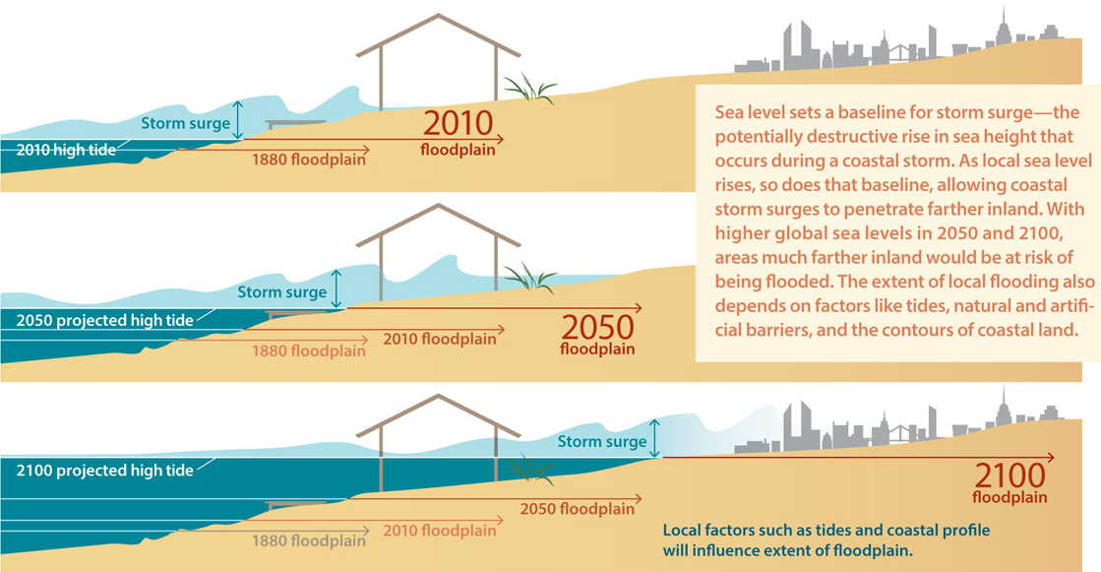

Slide 13
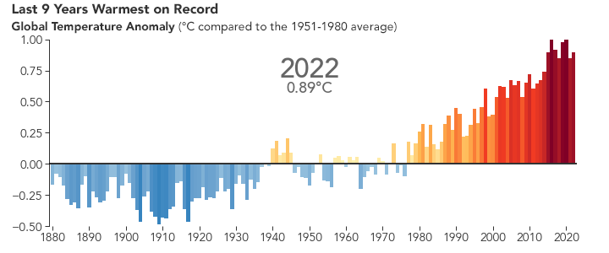
https://earthobservatory.nasa.gov/world-of-change/global-temperatures

Slide 14
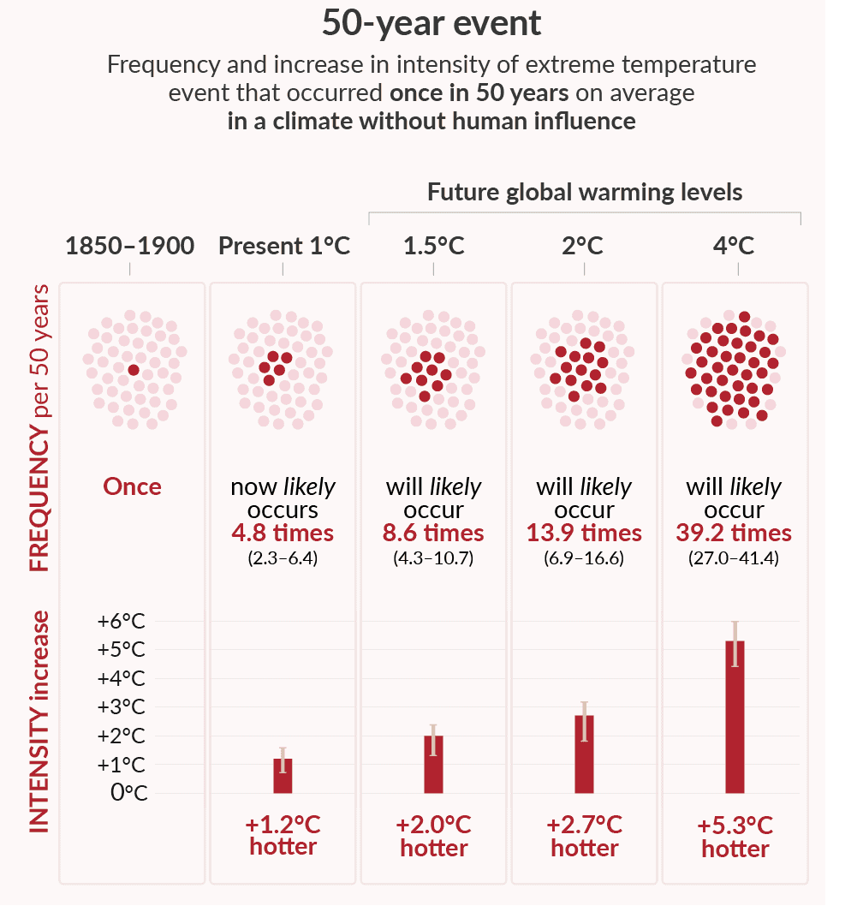
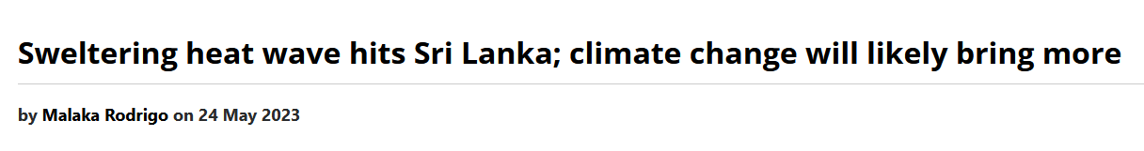
“As the temperature has risen to about 36 degrees Celsius [96.8 degrees Fahrenheit], Sri Lanka has experienced about 3 degrees Celsius [5.4 degrees Fahrenheit] increase of the daily maximum temperature during the recent heat stress period,”
https://www.ipcc.ch/report/ar6/wg1/figures/summary-for-policymakers/

Slide 15
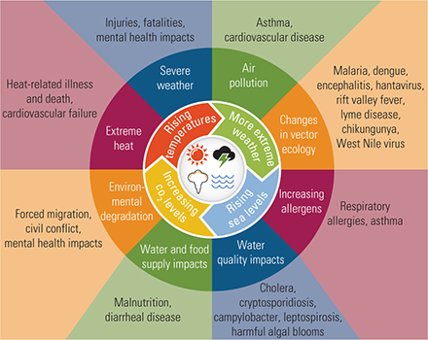
Climate Change & Human Health
Injury Prevention and Environmental Health. 3rd edition.

